Slide 1
Thinking About Identity and Ideologies
Specific outcomes 1.3, 1.5, 1.6 (chapter 1)

Slide 2
Chapter Issue:
To what extent are ideology and identity interrelated?
Inquiry Question #1:
What is the relationship between ideology and my identity?
Inquiry Question #2:
What factors influence individual and collective beliefs and values?
Inquiry Question #3:
What themes and characteristics should my ideology include?

Slide 3
Understandings of Identity
-who or what one is
-sense of personal continuityand being unique from others

Slide 4
Two types of Identity:
Personal Identity
What makes you unique
Collection of traits that distinguishes you from others
Collective Identity
One shared with a particular group of people.
e.g. Linguistic, faith, cultural, ethnic

Slide 5
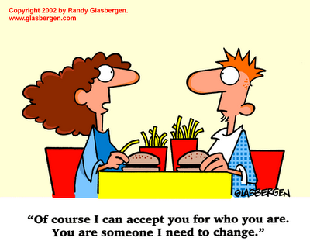
Identity can be influenced by gender, religion, language, or culture.

Slide 6
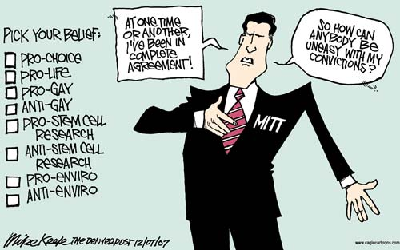
Beliefs and Values
Are important aspects of identity.
Influence our behaviour and choices and guide us in our interactions with others.

Slide 7
Ideology as an influence on identity
-ideology is a set of principles or ideas that explain our world and our place within it.

Slide 8
Various factors may influence your beliefs and values, as well as your individual and collective identities and personal identities.
E.g. Religion environment
spirituality media
gender language
ideology
relationship to the land
culture

Slide 9
First Nations Holistic Lifelong Learning Model
Nurturing Guides
-represents the link between First Nations lifelong learning and community well-being.
-framework for measuring success in lifelong learning
parents
Social
Economic
mentors
teachers
counsellors
elders
Spiritual &Cultural
Collective well-being
Political
Learning Rings of the Individual
Sources & domains of Knowledge
Other nations
languages
Traditions & ceremonies
nation
clan
Natural world
community
self
family
ancestors

Slide 10
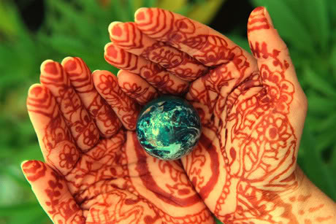
First Nations Purpose of Learning...
Honor and protect the earth and ensure the long-term sustainability of life
Holistic
Lifelong learning
Model uses a
Graphic model
of a living tree.

Slide 11
Learning Rings of the Individual
-depicts the cycles of learning for an individual and identifies the influences that affect individual learning and collective well-being. Fill in the bulls-eye (pg 24).
Intergenerational learning
Adult learning
Workplace learning
Post-second. education
Elem/secon. education
Early learning

Slide 12
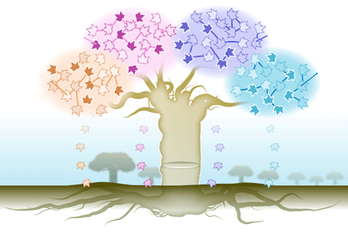
Metis Holistic Lifelong Learning Model.....label (pg26)
Explanation:

Slide 13
Who Are We? (pg 27)
Inquiry question #1:
What is the relationship between ideology and my identity?
-Brave New World (1932) Aldous Huxley describes a futuristic society where the state controls human reproduction and uses selective breeding to produce five separate castes or classes of people.

Slide 14
Brave New World
-each caste is genetically engineered to fulfill a specific range of roles in society.
-individuals are physically and intellectually matched to their prescribed roles
-they are psychologically conditioned to accept and enjoy their roles.
“that is the secret of happiness and virtue – liking what you’ve got to do”

Slide 15
Brave New World is the timeless tale of the problems associated with the creation of an “utopian” society. It highlights the fact that true happiness cannot be attained by the elimination of unhappiness. And unhappiness can never really be eliminated from a human society.

Slide 16
-Can Huxley’s fictional scenario be taken as a metaphor for today?
Discussion:
Do the immediate influences of family members and the more general influence of the culture in which we live, provide us with a predetermined worldview???

Slide 17
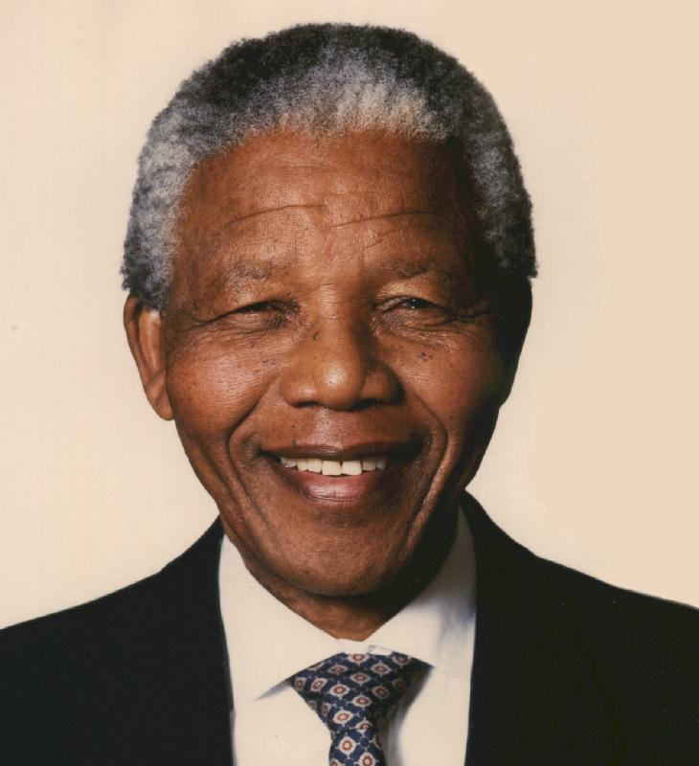
Inquiry question #2:
What factors influence individual and collective beliefs and values?
-considering the origins
of our ideas may cause
us to examine them further
and develop a deeper
understanding of them.
“No one is born hating another person because of the colour of his skin, or his background, or his religion. People must learn to hate...”
Nelson Mandela

Slide 18
Factors that influence the formation of beliefs and values
-family influence
-relating gender to beliefs and values
-Religion & Spirituality
-environment
-relationship to the land
-Language
-Media, beliefs, and values
-Government shaping Identity.

Slide 19
Family Influence
-the earliest influence
-has a strong influence on children’s identity.

Slide 20
Gender
-how a society perceives gender, sometimes legislating what is ‘appropriate’ gender expression, can also affect viewpoints on gender.
-society may assign specific gender roles to members – based on economic and religious factors, family, child security, and traditions.

Slide 21
Religion & Spirituality
-takes many forms
-can give meaning to people’s lives and provides a moral system that informs their actions.
-provides shared traditions and collective action.

Slide 22
Environment
-increasing environmental awareness has influenced the lives of many individuals.
-’environmental footprint’ awareness
-’green politics’ political ideology created by environmental-ism.

Slide 23
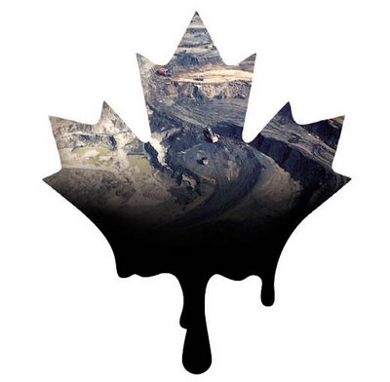
Relationship to the Land
-if an individuals livelihood is connected to land or natural resources, this can influence your identity.
-Aboriginal peoples have a long relationship to the land and has social, cultural, economic connection to the land.

Slide 24
Language
-way in which people communicate beliefs and values, worldview, cultural and societal understandings, and sense of self.
-linguistic minorities often struggle against assimilation.

Slide 25
Media, beliefs & Values
-Marshall McLuhan claimed that the ‘medium is the message’ – that the form of the communication was more important than the actual content.
-felt that if people were unaware of the effects of electronic media, it could be used against them to form totalitarian control.
-Hegemony (political control exerted by one group over others) may occur.

Slide 26
Government
-Canada is a multicultural society and is manifested as pluralism
-Pluralism is also manifested through official bilingualism, Charter of Rights, and constitutional guarantees of the First Nations, Inuit and Metis peoples.

Slide 27
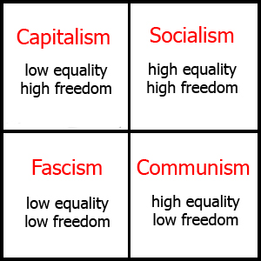
Inquiry question #3
What themes and characteristics should my ideology include?

Slide 28
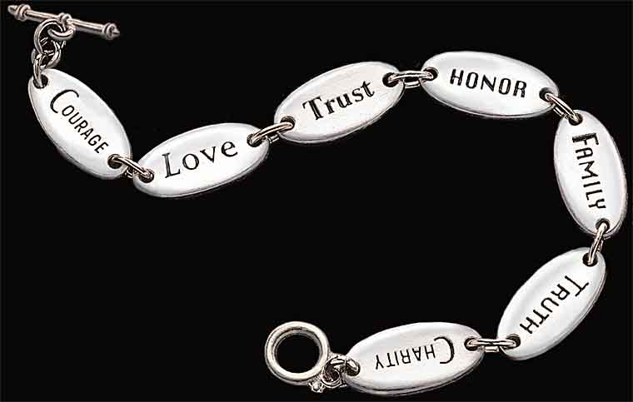
Characteristics of Ideology
A. Nature of Human Beings:
Whether people are essentially good or bad
If you are open to people, it is likely that you believe humans are essentially good
If you are cautious, likely you believe they are not.

Slide 29
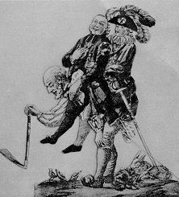
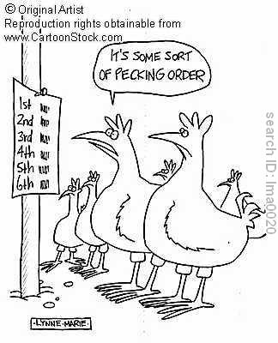
B. The Structure of Society
-social structures are what bend us together
as a society and help society function in an
orderly fashion.
-social structures of society reflects the
beliefs and values of the society

Slide 30
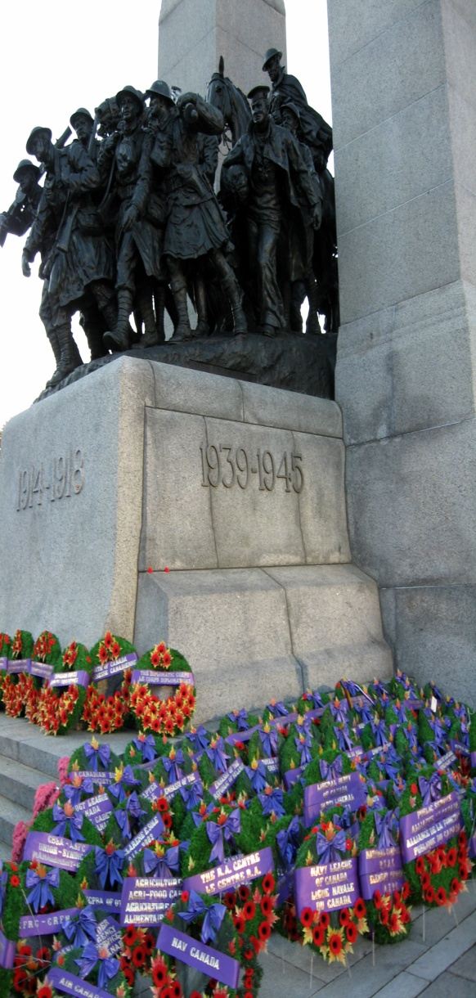
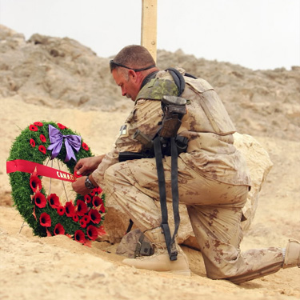
C. Interpretations of History
-past events tend to influence
the beliefs and values we hold.
-ideological interpretations of a country’s history affects the identities of its citizens. These interpretations often guide our actions.

Slide 31
D. Visions of the Future
-reflects how you see your future – as individuals and as a society.
-these visions will guide your actions.

Slide 32
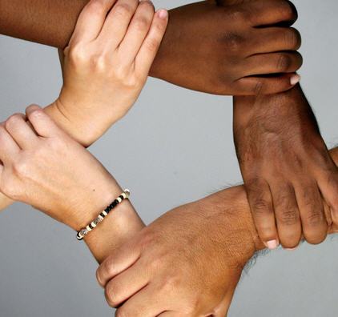
Themes of Ideology
Include: nation, class, race, environment and relationship to the land, gender, religion.
Often, one or two themes dominate an ideology.
e.g. Progressivism – ideologies that advocate moderate political and social
reform through government
action. Generally
support social justice
and workers rights.

Slide 33
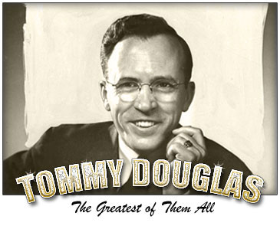
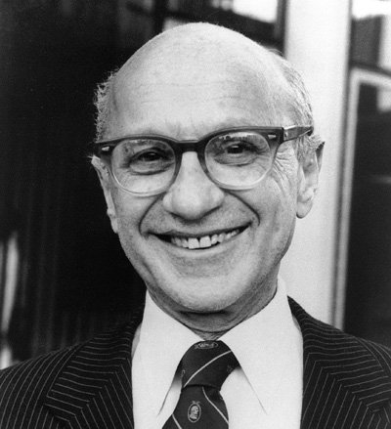
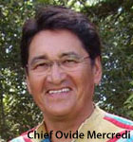
Different thinkers-different themes
Tommy Douglas-
Milton Friedman-
Ovide Mercredi-

Slide 34
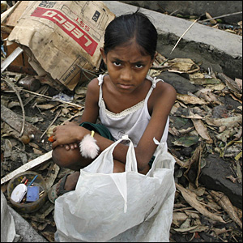
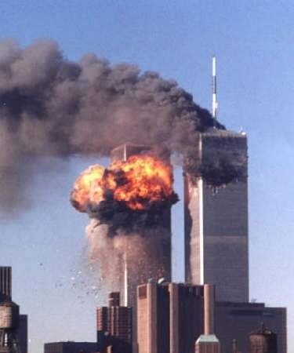
Government response to Crisis...
How do the actions of a country’s leaders in a time of crisis reflect the beliefs and values that underlie their ideology?

