Slide 1
Political Challenges to Liberalism
Chapter 10
Specific outcome 3.3
Explore the extent to which governments should reflect the will of the people.

Slide 2
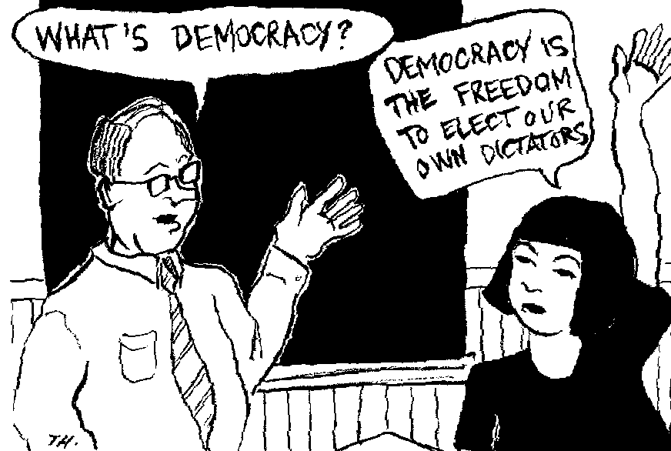
The Will of the People
According to liberal principles, the ordinary individual citizen (and the aggregated opinions of citizens, referred to as the ‘will of the people’) is central to the shape & workings of government.

Slide 3
Question is....
Are ordinary human beings capable of making wise judgements in matters concerning their own and other’s well-being?

Slide 4
The ideal...
Ideally, the governing system, its institutions, actions and legal structures, are designed with the individual citizen’s participation in mind.
That is of course, the ideal, and the actual practice, even within democratic governments, often falls far short of this ideal.

Slide 5
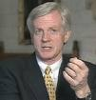
David Kilgour
First elected to the House of Commons in 1979 as a PC in an Edmonton riding.
Refused to support the introduction of the GST in 1990, he was expelled from the PC party.
Became a Liberal.
2005, he crossed the floor (resigned from the Liberal Party) because he opposed several Liberal policies.
Became an independent.

Slide 6
Opposed these party policies because of his own beliefs and the unpopularity of those policies in his riding.
He viewed his first duty was to represent the will of his constituents rather than the will of the party.
Tradition of Party solidarity is key to Canadian politics. All party members vote with the party.

Slide 7
In our parliamentary system, party solidarity prevails and each MP votes with his or her party.
Occasionally, MPs take a stand and refuse to endorse a policy with which their constituents disagree
This often means either the MP is forced out of the party, or they leave voluntarily (both happened to Kilgour.

Slide 8
Chapter Issue: To What extent should governments reflect the will of the people?
Democracy
Dictatorship
How do gov’ts attempt to follow the will of the people?
How, & to what extent, are gov’t actions that ignore the will of the people justified?

Slide 9
Does Government Serve the People or Lead the People?

Slide 10
Democratic Systems of Government

Slide 11
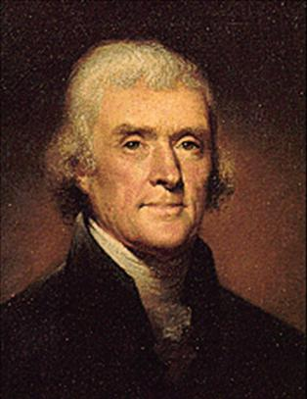
“The will of the people...is the only legitimate foundation of any gov’t, and to protect its free expression should be our first object.”
-Thomas Jefferson, 1801

Slide 12
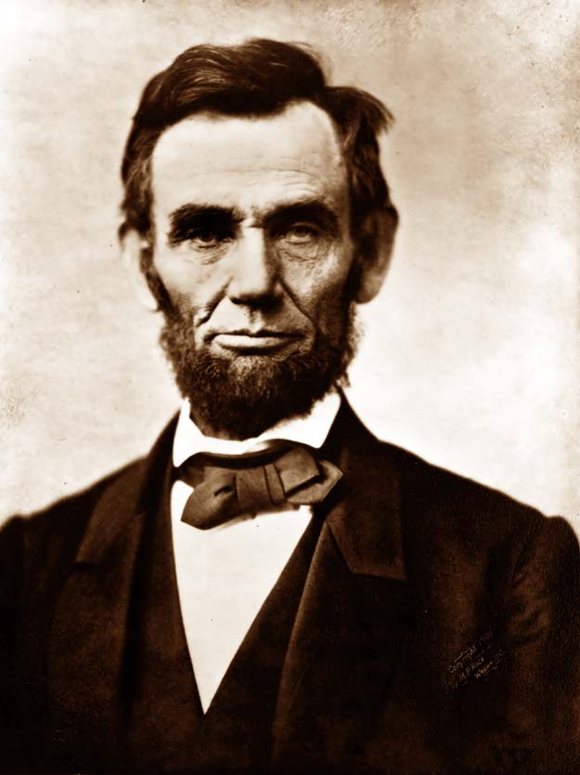
‘What I want is to get done what the people desire to have done, and the question for me is how to find that out exactly.’
-Abraham Lincoln 1809-65
(16th president of the USA)

Slide 13
Think Pair Share
How can a government determine what the will of the people is?
Do you believe that Canada, where a party often forms the government even though it receives less than 50 per cent of the votes, is governed according to the will of the people?
Is governance by the will of the people even a desirable or realistic goal?
Are there circumstances in which a government should act contrary to public opinion?
Is public opinion informed opinion?

Slide 14
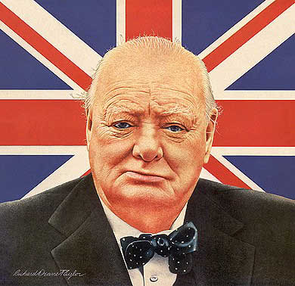
Read the quotes on page 336...
Suggests democracy is difficult to put into practice, but most would agree with Churchill’s quote:
“Democracy is the worst form
of government, except all
those other forms that have
been tried from time to time”.

Slide 15
"The public have an insatiable curiosity to know everything. Except what is worth knowing. Journalism, conscious of this, and having tradesman-like habits, supplies their demands." Oscar Wilde
"Under democracy one party always devotes its chief energies to trying to prove that the other party is unfit to rule - and both commonly succeed, and are right." H. L. Mencken
"It is dangerous for a national candidate to say things that people might remember." Eugene McCarthy
"A government of the people, by the people, and for the people shall not perish from the earth." Abraham Lincoln

Slide 16
"These are the people we elected and if we are not satisfied we should get new candidates. It is in our hands. It is our country. It is a very simplistic view that politicians are to blame for everything." Robert Stanfield, former Conservative Leader and Premier of Nova Scotia
“A democracy is nothing more than mob rule, where fifty-one percent of the people may take away the rights of
"Don't vote, it only encourages them." Anonymous
"If pigs could vote, the man with the slop bucket would be elected swineherd every time, no matter how much slaughtering he did on the side." Orson Scott Card, Novelist

Slide 17
"Democracy is a form of government that substitutes election by the incompetent many for appointment by the corrupt few." George Bernard Shaw
"Democracy is the recurrent suspicion that more than half of the people are right more than half of the time." E. B. White
"Democracy is the theory that the common people know what they want and deserve to get it good and hard." H. L. Mencken
"Loyalty to a petrified opinion never yet broke a chain or freed a human soul." Mark Twain

Slide 18
How do Governments attempt to follow the will of the people?
“As citizens of this democracy, you are the rulers, and the ruled, the lawgivers and the law-abiding, the beginning and the end”.
-Adlai Stevenson (US politician) 1952
Democracy – form of government in which power is ultimately vested in the people

Slide 19
Two Forms of Democracy
Direct – the people participate in deciding issues directly . Operates on the belief that every citizen’s voice is important and necessary for the orderly and efficient operation of society.
Representative – through elected officials who represent them and make laws in their interests.

Slide 20
The Will of the people...Think, share!
Is it sufficient for governments to win the support of voters during periodic elections or should they rely on public opinion polls to guide day-to-day and issue-by-issue decisions?
How much influence should the general population have on government policies?

Slide 21
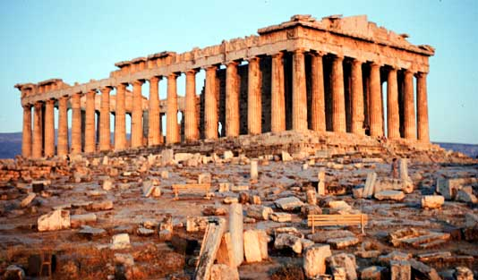
Principles of Liberalism in Direct Democracies
Seems practical with small numbers of people. It requires everyone to get together in one space to discuss issues, then make decisions on the majority vote.
Ancient Athens –
the world’s first
democracy – direct
democracy with
5000-6000 people.

Slide 22
Three instruments of Direct Democracy used in Liberal Democracies...
Initiatives – used to create legislation in the USA. A citizen’s group draws up a petition. If the petition is signed by a certain number of citizens, it can force a public vote on an issue.
e.g. Proposition 6: to get tougher sentencing for gang-related violence.
Proposition 10: to provide rebates to citizens
who buy cars that use alternative fuels.

Slide 23
Referendums or Plebiscites – all citizens may vote on whether to accept or reject a proposed piece of legislation. Refer the vote to the citizens (referendum = binding)
e.g. Canadian Referendum- 1992 – proposed changes to the Charlottetown Accord (defeated).

Slide 24
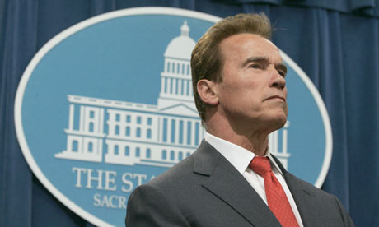
3. Recall Election - a majority of voters may choose to remove an elected official or government from power. In Canada, BC is the only province that allows recalls (1995). Petition – Speaker announces the recall – a bi-election is held. In the USA, Arnold Schwarzenegger was elected in 2003 in the state’s first ever recall election.

Slide 25
Liberalism through Representative Democracy...
Representative Democracy – citizens elect governing officials to make decisions on their behalf.
Most modern liberal democracies, because of their size and complexity use representative democracy.

Slide 26
Features of a Representative Democracy (pg 339)
Complete the diagram....
Accountability of Elected Representatives

Slide 27
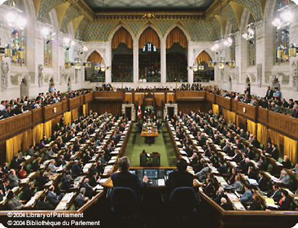
Canadian Parliamentary Democracy
Many variations of representative democracies.
Canada – uses responsible government – the branch of gov’t that proposes laws (exec – PM & cabinet) is dependent on the direct or indirect support of elected members of the legislative branch (a majority of mp’s in the H of C)

Slide 28
Calling an election...
If the legislature, which officially represents the will of the people, does not approve of important laws proposed by the executive branch (spending, taxation, budget), then the executive branch may be forced to resign or call an election.

Slide 29
Accountability...
Responsible government is about accountability: the PM and cabinet ministers need to be accountable not only to Parliament, but also to their constituents and Canadians as a whole.
If they are suspected of not carrying out the will of the people, a motion of non-confidence may be proposed in the House of Commons. If it passes, the gov’t must resign or submit an election
e.g. Harper comes to power after vote of non-confidence against then PM Paul Martin.

Slide 30
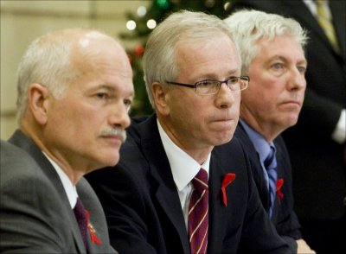
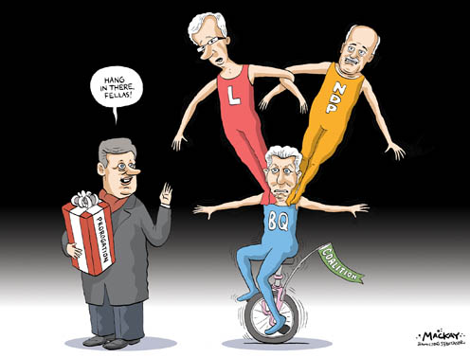
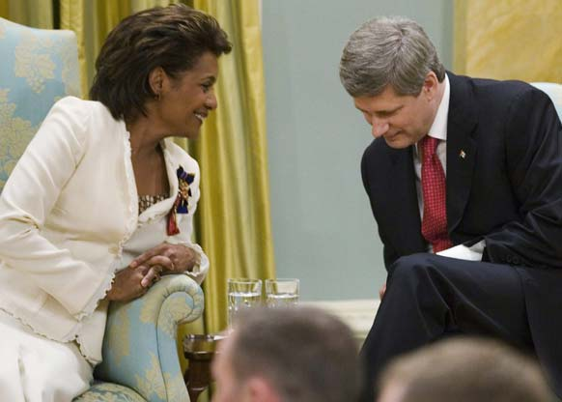

Slide 31
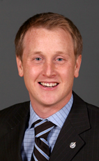
Single-member Constituency
Operates on the basis of representation by population.
Electoral districts, ideally 100,000 people, are created across Canada into what are called ridings, or constituencies.
Each constituency sends a single rep. to
the House of Commons in the federal
Parliament in Ottawa which is known
as single-member constituency.

Slide 32
First-past-the-post...
Candidate who pass a certain point in the race with the highest number of votes in each of their ridings win.
At present their are 308 Members of Parliament.

Slide 33
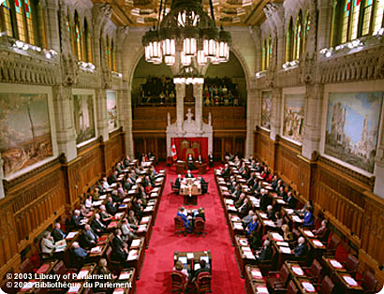
Bicameral
Canada has a bicameral
(Two chamber) government system.
Senate – Upper house. 105-member Senate is based on representation by region rather than on rep. by pop. Senators are appointed by PM – until age 75. Any piece of legislation that passes out of the H of C must also be passed by the Senate. Often suggest amendments.
House of Commons – lower house.

Slide 34
The United States’ Republican Democracy and Sweden’s Proportional Representation ( summative assessment)
Task: Create 3 diagrams in your notes that outlines the American system of government and Sweden’s Proportional Representation system, and Canada’s Parliamentary gov’t. Use pages 341-45 in your text or the internet to assist you.
See next page for suggestions

Slide 35
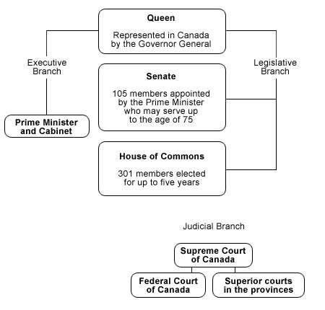

Slide 36
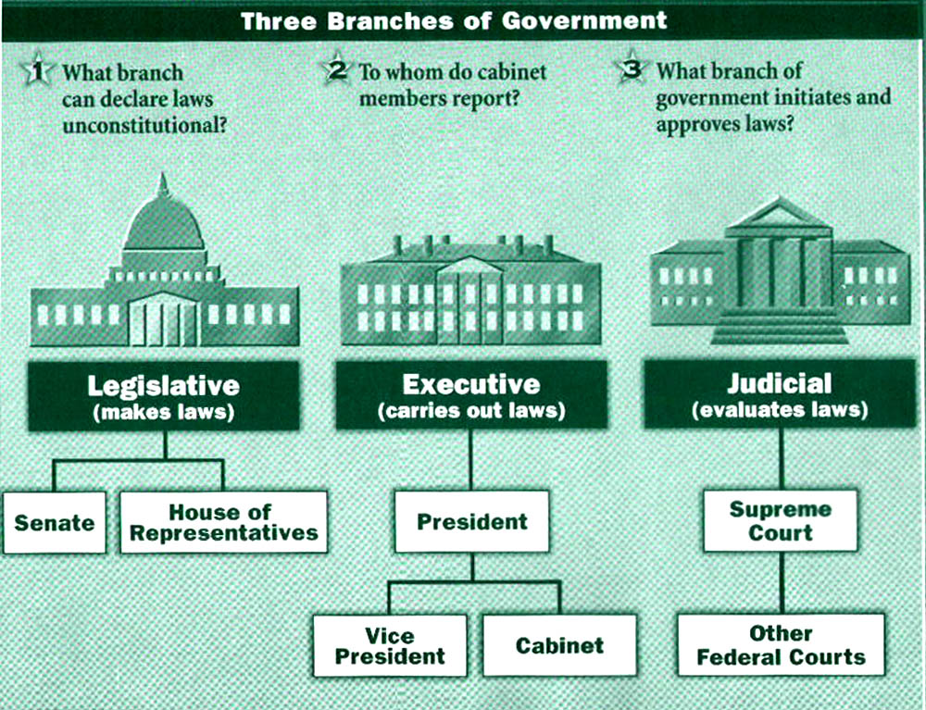
United States Government

Slide 37
Things to Consider:
Name 0f system of government
Head of State
Head of government
Branches of government and roles/responsibilities
Election system details – electoral methods
How a law is passed
How a government is formed and stays in power or is removed from power
Challenges going forward

Slide 38
Challenges to the Will of the People... WE DON’T CARE...
Often, citizens’ are not educated in the area of politics.
“Any democracy must pay explicit attention to the development of young peoples’ civic skills, habits and attitudes. We human beings do not instinctively develop the skills necessary for democracy. We are not automatically capable of working together with others on common problems. We do not naturally understand alternative perspectives. Unless we are taught to care about other people, we are unlikely to show concern from anyone beyond our immediate circle of family and friends. Citizens are made, not born...” - Peter Levine, October 14, 2005

Slide 39
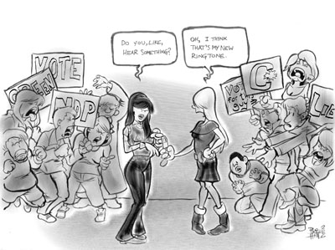
Voter Turnout...
Evidence suggests that people are failing to execute even the minimal expectation of democracy by not exercising their right to vote (indifference).

Slide 40
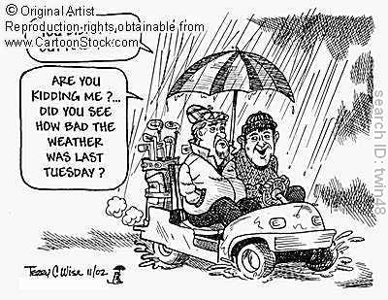
Voter turnout...
If power resides with the people, what do you do when the people choose not to exercise that power?
How does low voter turnout undermine or endanger a democratic process?

Slide 41
Mandatory Voting???
Should voting be compulsory in Canada?
Read pages 348-349 in your textbook and complete the Questions for Reflection on page 349.
Discuss as a class your responses.

Slide 42
Elite Theories of Democracy
Some people claim that the needs of a society are best served when one elite group of people, deemed to be better qualified than other citizens, is given the task of making decisions for all.
Thomas Hobbes, argued because a single vote has little weight in a very large group of decision makers, individuals have little or no sense of responsibility for their decisions, and thus are less likely to make rational well informed decisions.
This obviously poses a dilemma (elite group vs. Educating citizens – neglect other societal duties?)

Slide 43
"Never doubt that a small group of thoughtful citizens can change the world. Indeed, it is the only thing that ever has." Margaret Mead

Slide 44
Lobbying by Interest Groups...
Is an attempt to influence the direction of governmental policy by groups that represent a particular interest or perspective.
Spend time and raise money to influence public policy.
Can the will of the people be
overridden by the will of a
group of well-organized,
vocal and influential people?

Slide 45
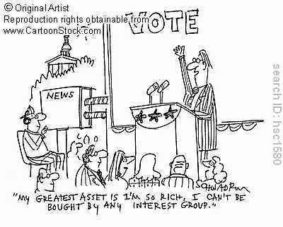
Ethics and the Common Good
Does the will of the
people necessarily indicate
the right course of action?
Tyranny of the Majority –
(John Stuart Mill) used this
term to describe one of the potential problems in a democracy. The will of the majority may be imposed on minorities to the detriment of other liberal principles.

Slide 46
Same Sex Marriage
In 2005, for example, when the government of Canada introduced legislation into Parliament to recognize same-sex marriages, some Canadians wanted a referendum to be held on the issue so they could express their opinions.
Didn’t happen...Justice Minister Irvin Cotler stated that if a referendum had been held to decide whether women were entitled to vote in the early 20th century, women would likely never have been enfranchised.
Favoring the extension of rights over the will of the people? Was this right???

Slide 47
Other Canadian Examples...
Abolition of capital punishment in Canada (1976) after 109 years and 710 executions. 60% of Canadians favoured keeping it, while Parliament holding a vote, voted to abolish it. (131 – 124 MPs in favour of abolishing).
Currently in Canada, juvenile offenders are being tried as minors in the criminal justice system. (heinous crimes)
Quebec expressing concern over accommodating other cultural practices within Quebec.

Slide 48
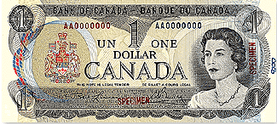
Practicality versus Popular Opinion
Sometimes governments make unpopular decisions because they believe they are necessary for the common good. E.g. Replacing the one dollar bill with a coin (saving of $250 million in the next 20 years)

Slide 49
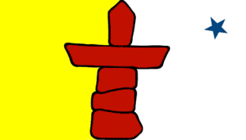
Consensus Decision Making
A group of individuals share ideas, solutions, and concerns to find a resolution to a problem that all members of the group can accept.
Gov’t of Nunavut and the Northwest Territories are consensus governments. In Nunavut,
there are no political parties, which
allows MP’s to vote on how they think
is best.

Slide 50
Authoritarianism
How, and to what extent, are government actions that ignore the will of the people justified?
“We embody the will of the people because we have the best interests of the people at heart”

Slide 51
“Power is not a means, it is an end. One does not establish a dictatorship in order to safeguard a revolution; one makes the revolution in order to establish the dictatorship.” - George Orwell
“A dictatorship would be a heck of a lot easier, there's no question about it.” - George W. Bush
“I believe in benevolent dictatorship provided I am the dictator” - Richard Branson
“Whenever you have efficient government, you have a dictatorship” - Harry S Truman
“It is a paradox that every dictator has climbed to power on the ladder of free speech. Immediately on attaining power each dictator has suppressed all free speech except his own.” - Herbert Hoover

Slide 52
“Dictatorship is a constant lecture instructing you that your feelings, your thoughts and desires are of no account, that you are a nobody and must live as you are told by other people who desire and think for you” - Stephen Vizinczey
It has been claimed at times that our modern age of technology facilitates dictatorship. - Henry A. Wallace
Propaganda is to a democracy what violence is to a dictatorship. - William Blum
Television has made dictatorship impossible but democracy unbearable. - Shimon Peres
We are moving toward a dictatorship of relativism which does not recognize anything as for certain and which has as its highest goal one's own ego and one's own desires. - Joseph Ratzinger

Slide 53
Authoritarianism...
Describes a form of government that vests authority in an elite group that may or may not rule in the interest of the people.
Authoritarian political systems take many forms, including oligarchies (Putin’s Russian Federation), Military dictatorships (Myanmar, formerly Burma) and one-party states (Cuba) and Monarchies (Saudi Arabia).

Slide 54
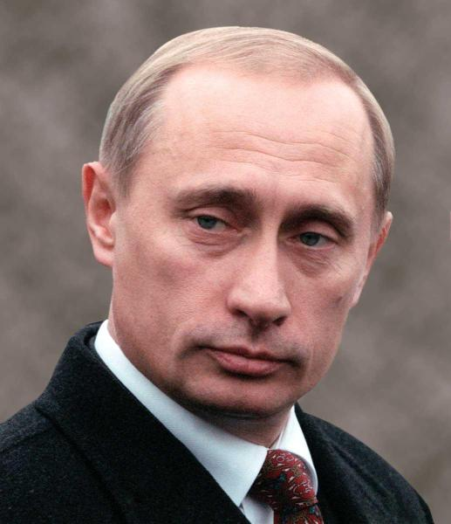
Oligarchies...
A form of government in which political power rests with a small elite segment of society.
Often controlled by politically powerful families who pass on their influence to their children. (Russia)

Slide 55
‘Iron Law of Oligarchy’
Some scholars believe that any political system eventually becomes an oligarchy.
“came to the conclusion that the formal organization of bureaucracies inevitably leads to oligarchy...under which organizations originally idealistic and democratic eventually come to be dominated by a small, self-serving group of people who achieved positions of power and responsibility. This can occur in large organizations because it becomes physically impossible for everyone to get together every time a decision has to be made. Consequently, a small group is given the responsibility of making decisions.” -Robert Michaels, from The Iron Law of Oligarchy

Slide 56
Are some Modern Democracies Oligarchic?
Eg – USA. Actual differences between rivals is small. The oligarchic elite impose strict limits on what constitutes an acceptable and respectable political position.
Is it any coincidence that the names Clinton and Bush have prevailed in four recent US election campaigns?

Slide 57
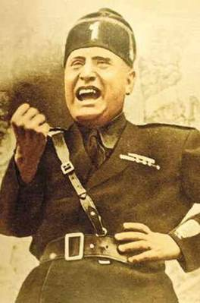
One-Party States
A type of system where only one party forms the government and no other parties are permitted to run candidates.
Often communist states, yet call themselves republics, socialist republics, democratic republics to show they somehow represent the will of the people.
Provide unity, strength

Slide 58
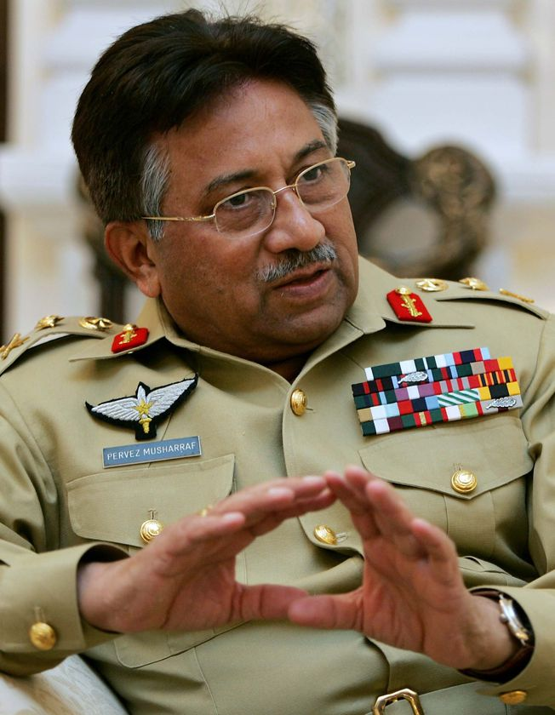
Military Dictatorships
Often known as a military junta, where political power resides with the military leadership.
Often come to power through a coup d’etat
E.g. Musharraf – Pakistan – forced out of power in 2007 (internal dissension b/n pro-Islamic and pro-democratic factions)

Slide 59
Techniques of Authoritarian Governments
Vision –what the country could be if led by...
Propaganda – messages designed to influence the opinions and behaviours of large groups of people
Controlled Participation – citizens belief they are contributing to the country (rallies)
Directing Public Discontent – society is provided an enemy on which they can safely unleash their frustrations. (Hitler – anti-semitism)
Terror – quick terror to rid society of dissedents

Slide 60
Strengths & Weaknesses of Authoritarianism
Strengths
Weaknesses
Seem to accomplish many of the country’s goals
Visions painted by dictator often address the needs of the people and often result in positive consequences (build roads).
Horrible acts of human rights violations
Often corrupt (Ferdinand Marcos -Philippines 1965-1986)
Often sacrificed individual citizens for the perceived needs of the country
Often leadership change is not done peacefully.
Popular support disappears, violence often occurs.

Slide 61
Are there circumstances in which an authoritarian regime can be seen as an expression of the will of the people?

Slide 62
Portrait of a Dictator (summative assessment)
Choose a 20th Century dictator on the handout provided and complete a one page description (publisher) of his:
Rise to power,
What he accomplished in power,
His fall from power.
Indicate the dictator’s perspective on the concept of the will of the people.
http://www.parade.com/dictators/2009/

