Slide 1
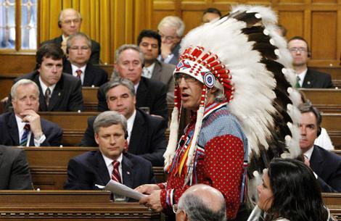
S.O. 2.11 – Examine perspectives on the imposition of liberalism
Ch. 9 – Imposing liberalism

Slide 2
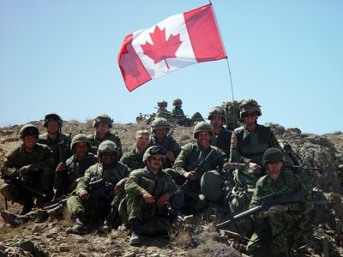
The Story Thus Far:
So far this unit, we’ve talked about the roots of liberalism, impacts of and responses to classical liberalism (socialism, Marxism), the rejection of liberalism (communism, fascism), and the impact of ideologies in conflict (Cold War). In Chapter 9, we look at the imposition of liberalism and some of its effects

Slide 3
Imposition of Liberalism: Warm Up
Bill 16 - Distracted Driving Legislation
Driver distraction is a growing traffic safety concern among policy makers and the public. International studies have shown that 20 to 30 percent of collisions involve driver distraction. Alberta has taken a leadership role to address this serious traffic safety issue by recently passing Bill 16- the Traffic Safety (Distracted Driving) Amendment Act, 2010-to help make our roads safer.

Slide 4
Highlights:
Restricts drivers from:
using hand-held cell phones
texting or e-mailing
using electronic devices like laptop computers, video games, cameras, video entertainment displays and programming portable audio players (e.g., MP3 players)
entering information on GPS units
reading printed materials in the vehicle
writing, printing or sketching, and
personal grooming
Complements the current driving without due care and attention legislation
Applies to all vehicles as defined by the Traffic Safety Act including bicycles
Applies to all roads in both urban and rural areas of the province

Slide 5
Questions:
Is this law necessary?
Is the punishment necessary? Sufficient?
What is the desired result?
Is there an alternative way to achieve the desired result?
What will the effect of this legislation be?
Is this an example of classical or modern liberal thinking?
Should liberalism be imposed on everyone?

Slide 6
Imposing liberalism
Imposition (or imposing) means forcing something on people whether they want it or not. Liberalism has been imposed on people at various points in history, sometimes with negative consequences
Today, we’ll look at the imposition of liberalism in Canada and in other countries

Slide 7
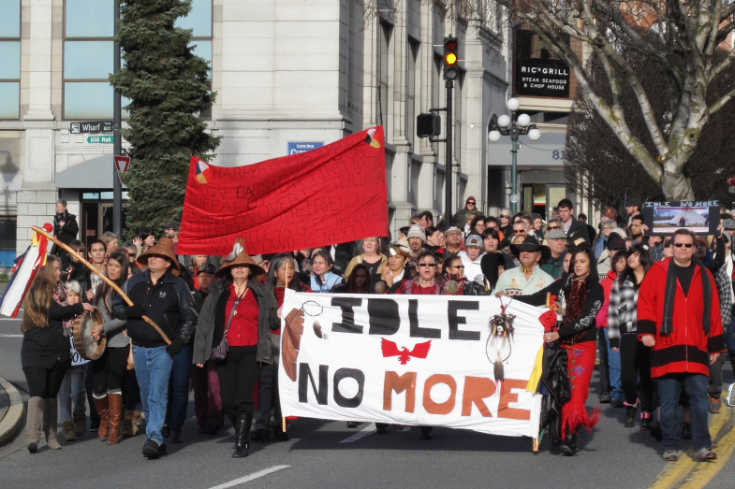
Aboriginal Experiences with Liberalism

Slide 8
Aboriginal experiences of liberalism
As we know, contact between First Nations in Canada and European settlers presented conflicting worldviews and ideologies. Most European settlers brought with them liberal values and beliefs, while many First Nations believed in collectivist ideas
Subsequently, values of liberalism would be imposed on Aboriginals in an attempt to assimilate them into “mainstream” Canadian society

Slide 9
Different views on treaties
First Nations | Government of Canada
Treaties are agreements made between sovereign nations, upheld by oral tradition | Treaties are agreements made by interested parties, upheld by a written document
Relationship with land is collective, spiritual. Land provided by Creator, and people exist in harmony with the land | Land is a resource that can be owned by individuals for their own use
Treaties were established to share the land with newcomers | Treaties were established to clear way for European settlement

Slide 10
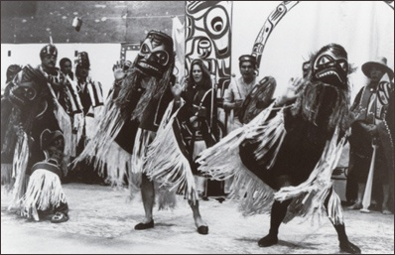

Slide 11
Attempts at Assimilation:
Resistance by Aboriginals to liberal values was not accepted by the Canadian government. This led to policies of assimilation, a plan to impose adherence to liberal goals on Aboriginals
Under these policies Aboriginals were supposed to give up their distinct cultures and traditions, such as the potlatch

Slide 12
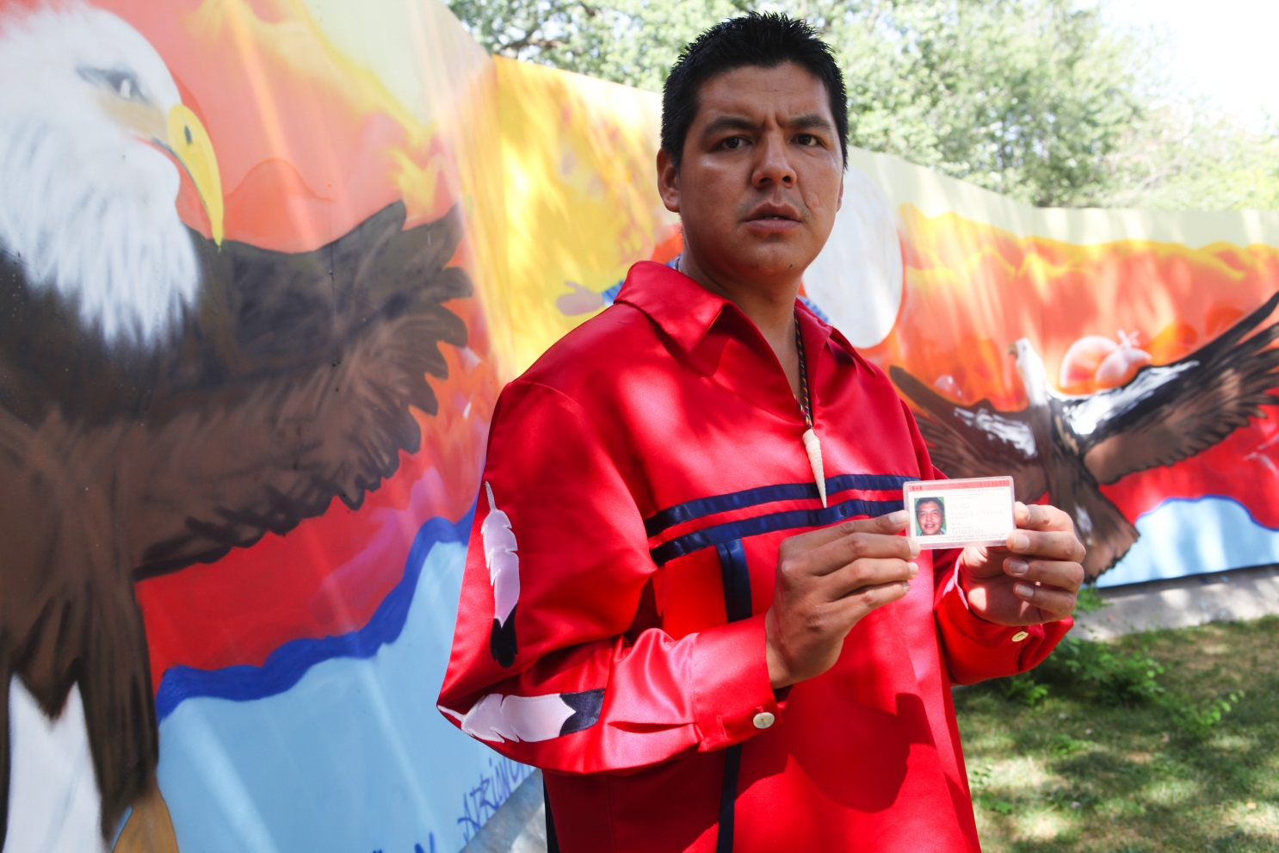
Beausoleil First Nation members Richard Peters and Johnny Hawke were rebuffed from returning their Indian Status Cards at an Ontario Regional Indian Affairs Branch.
“People think their rights are tied solely to a Status Card that allows them to have all the little amenities we have,” Peters told Indian Country Today Media Network. “But by using these cards, it allows the government to continue to enforce the Indian Act on us. The Indian Act is the most racist (law).”
Wearing a traditional ribbon shirt, Peters displayed his status card, adding that when he tried to relinquish status, he was warned he could lose both his aboriginal rights and his Canadian citizenship.
“Until you can prove you’re sovereign, you’re kind of stuck in a hole,” he said. “We don’t want to be governed by this. We don’t want to be under the Indian Act.”

Slide 13
The Indian Act of 1876
This act was used by government to control the behaviour of First Nations peoples and remove their traditions and customs. They were encouraged to leave their Indian status to become “full” citizens of Canada. They were seen as “children” or wards of the state, who needed to be taken care of
The Indian Act took away their collective rights through its policies of assimilation into the more individualistic liberal society

Slide 14
Since 1876, the Indian Act has been amended several times, but has never been abolished. Some examples:
1884 – prohibited religious ceremonies (potlatch, etc.)
1951 – loss of Indian status for women who married non-status men
1969 – The White Paper proposed by gov’t – sought to abolish all evidence of relations between Canada and First Nations. Purpose was to enable Aboriginals to become “free” members of Canada’s liberal democracy, where the rights of the individual are more important than the collective
1969 – Aboriginals respond by publishing the Red Paper, which objected to what they saw as the government’s attempt to impose liberalism on them
1985 – Women could keep or regain their status even after marrying a non-status man and children of such a marriage were granted status

Slide 15
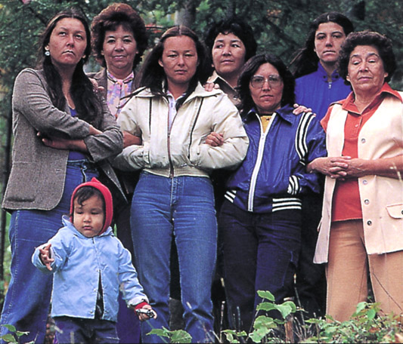
The Indian Act affected female identity because women were removed from their traditional positions of power and importance. Gender inequality was partially removed with the ruling in 1985 that reinstated their status rights

Slide 16
Land Claims and the Constitution
Aboriginal Land Claims are a major concern for Canada going forward
The government has not signed treaties with many of Canada’s First Nations – even though they were dispossessed of their lands
In 2007 there were 861 unsatisfied claims by 445 First Nations – with 60 new claims being added on average each year

Slide 17
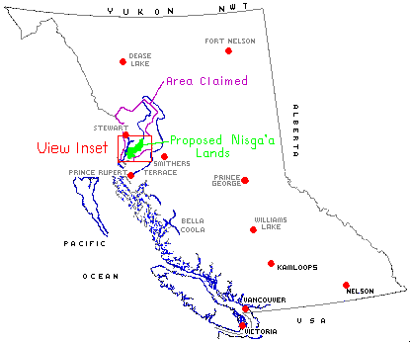
Case Study: The Nisga
The Nisga Final Agreement Land Claim settlement in 2000:
Nisga granted complete control over their land
Nisga must grant reasonable public access
Nisga laws that would restrict land use or resource use must be approved by the provincial and federal government

Slide 18
Nisga must write a constitution to govern their people
Important Aspects:
Must be approved by referendum (70% Nisga people must agree)
Ability to make laws, create public institutions (hospitals and schools) and separate police board
They are still subject to the Charter of Rights and Freedoms and Criminal Code
If Nisga law cannot conflict with provincial of federal law

Slide 19
The Royal Commission on Aboriginal Peoples and Healing Fund
Findings were published in 1996 – stated that Aboriginals in Canada must have the right to decide for themselves what they need including:
The creation of legislation recognizing the sovereignty of Aboriginal Peoples
The creation of institutions of Aboriginal self-government
The creation of initiatives to address social, education, health, and housing needs

Slide 20
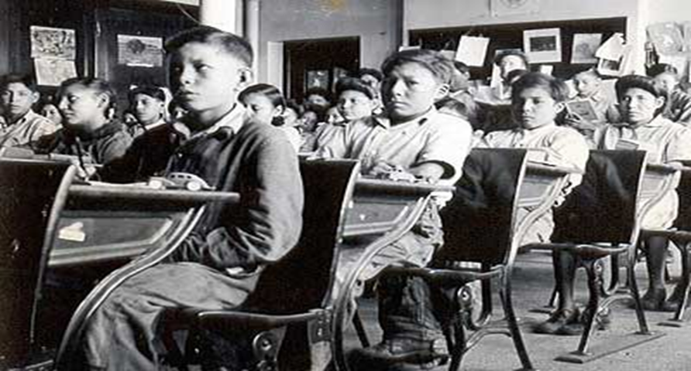
Since 1996, many people have been critical of what they see as a lack of government action to address some of the recommendation’s concerns
One positive result of the Commission’s recommendations was the creation of the Aboriginal Healing Foundation. Its mission is to encourage and support Aboriginals in their recovery from physical and sexual abuse that many suffered in the residential school system. To accomplish this, more than $400 million was awarded to various programs across Canada. The Assembly of First Nations has called the program a success

Slide 21
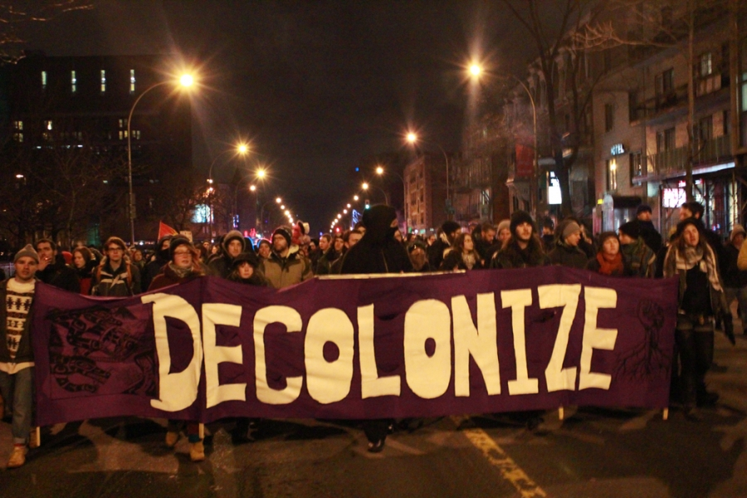
Idle No More

Slide 22
Idle No More Background
Idle No More is an ongoing protest movement originating among the Aboriginal peoples in Canada comprising the First Nations, Métis and Inuit peoples and their non-Aboriginal supporters in Canada, and to a lesser extent, internationally.
It has consisted of a number of political actions worldwide, inspired in part by the liquid diet hunger strike of Attawapiskat Chief Theresa Spence and further coordinated via social media.
A reaction to alleged legislative abuses of indigenous treaty rights by the current federal government, the movement takes particular issue with the recent omnibus bill Bill C-45.

Slide 23
Idle No More Focus
To date the movement has been particularly focused on:
(A) The education and the revitalization of indigenous peoples through awareness and empowerment.
(B) Encouraging knowledge sharing about indigenous sovereignty and environmental protections.
The press release also notes that "As a grassroots movement, clearly no political organization speaks for Idle No More".

Slide 24
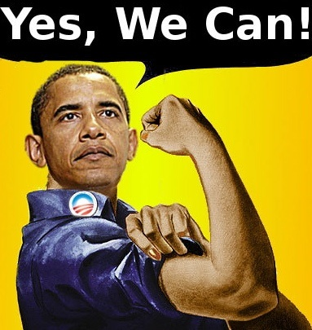
The imposition of liberalism in the world

Slide 25
Should liberalism be imposed on everybody?
What if another country or the United Nations invaded Canada, took control here, and tried to impose an ideology on Canada?
This sounds unlikely, yet millions of people around the world has experienced a similar situation. Some people in war-torn countries welcome peacekeepers, others do not
Why should liberalism be imposed on those who do not want it?

Slide 26
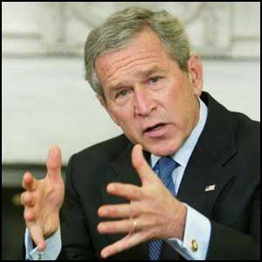
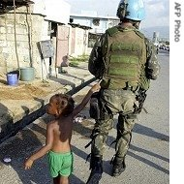
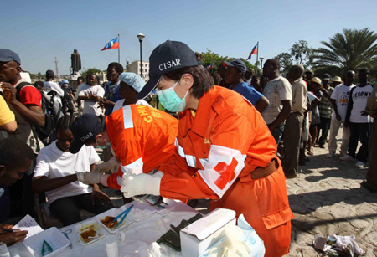
Two main reasons why one country may try and impose liberalism on another:
National interest: imposing liberalism to eliminate or reduce terrorist threats or for reasons of economic interest
Humanitarianism: imposing liberalism for moral or ethical reasons, such as to improve living conditions or to stop human rights violations

Slide 27
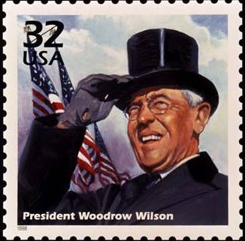
Imposing liberalism for National Interest
At the end of WWI, U.S. President Wilson insisted that Germany and its allies had to agree to establish democratic governments as a condition of the peace treaties. His view was that democracy and self-determination had to be established in Europe as a basis for peace

Slide 28
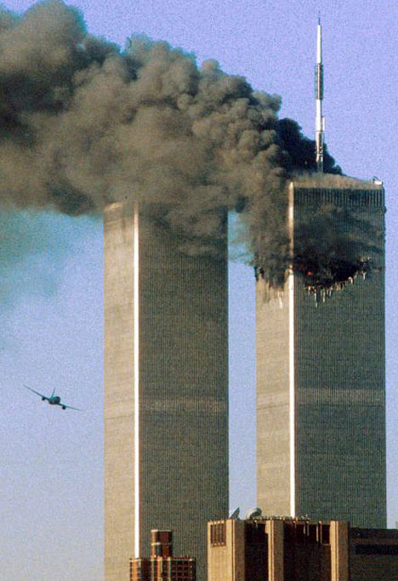
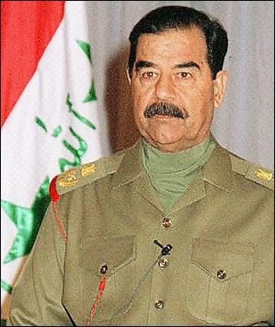
Imposing liberalism by the use of force
Some believe that if more countries embraced the ideology of liberal democracy, then the world would be a safer place. This belief was used to justify the “war on terror” after the 9/11 attacks. The U.S. and allies invaded Afghanistan to take the Taliban regime out of power (they had aided the 9/11 terrorists)
Democratic elections were held in 2004
The U.S. invaded Iraq in 2003 based on the same premise. However, the war in Iraq did not receive international approval

Slide 29
Imposing liberalism for humanitarian reasons
Some people believe that liberal countries should not tolerate non-liberal countries that deny their citizens’ human rights. Is intervention justified in these cases?
Forceful intervention in a foreign country does not always guarantee improved living conditions for the citizens of that country. The U.S.-led war on terror was partly based on human rights issues. Under the Taliban, Afghan women were denied basic human rights, and Saddam Hussein’s reign over Iraq was characterized by fear, crimes against humanity, and brutal torture tactics

Slide 30
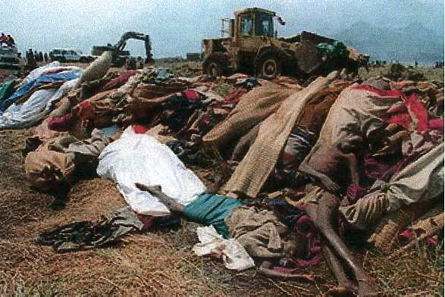
Reactions to the imposition of democracy
Rwanda
Western governments insisted that the country should have democratic elections. A coalition government was formed, and as a result conflicts between ethnic groups arose which led to the 1994 genocide
One journalist compared the West’s attempts at imposing liberal democracy on other countries to the colonial rulers who forced Aboriginal peoples to replace their own governing systems with colonial systems

Slide 31
Indonesia
After WWII, it was ruled as a military dictatorship. In 1998, the government faced an economic crisis; the IMF denied financial support in an attempt to force the country to use more democratic means. The country’s first parliamentary election was held in 1999
While the country faces ongoing challenges, Indonesians seem to have embraced the values of liberal democracy

Slide 32
So…should liberalism be imposed?
Depends on a lot of factors
Tom Keating, a professor at the U of A, says that many of the violent conflicts in the world since WWI have occurred within countries such as Rwanda and Bosnia rather than between countries. Referring to Canada’s foreign policy, Keating argues that the health of a country’s political institutions depends on its own citizens, not on foreign intervention

Slide 33
Imposition Assignment:
In small groups (1-4 max) do a quick research on a contemporary of historical example of a Western Nation that has attempted to impose Liberalism on another people
A. Briefly summarize the case study/example
Who was involved?
When did it happen?
What happened?
Why did the western nation attempt to impose liberalism?
How did the people upon which liberalism was imposed react?
Was it successful?
B. To what extent, and for whom, has the imposition of liberalism in your case study been successful?
C. Was the imposition of Liberalism justifiable in your case study?

