Slide 1
20th Century rejections of liberalism
Chapter 5

Slide 2
Bloody Sunday
January 1905 workers in Russia marched to present a petition to the Czar asking for recognition of basic human rights such as freedom of speech, press, religion, etc.
They also asked for a state-sponsored education system, better working conditions, fairer wages, an 8 hour workday, etc.
Hundreds were gunned down.
Russians were outraged and grew more dissatisfied. This eventually led to the Russian Revolution in 1917.

Slide 3
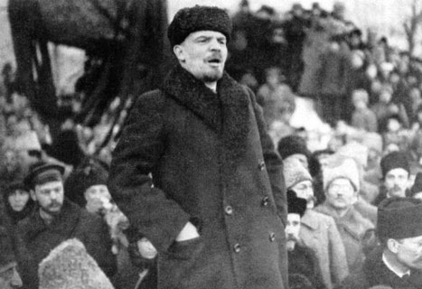
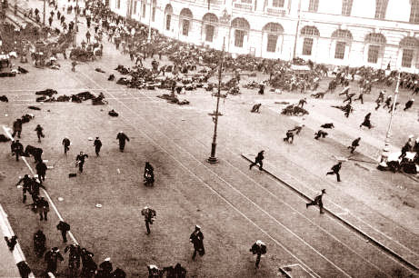
The Russian Revolution
The Russian Revolution was a reaction to the injustices of the authoritarian czarist system and uncontrolled free-market capitalism which exploited the proletariat (workers).
The Bolsheviks (communists), under Vladamir Lenin, sought to destroy this class-based system.

Slide 4
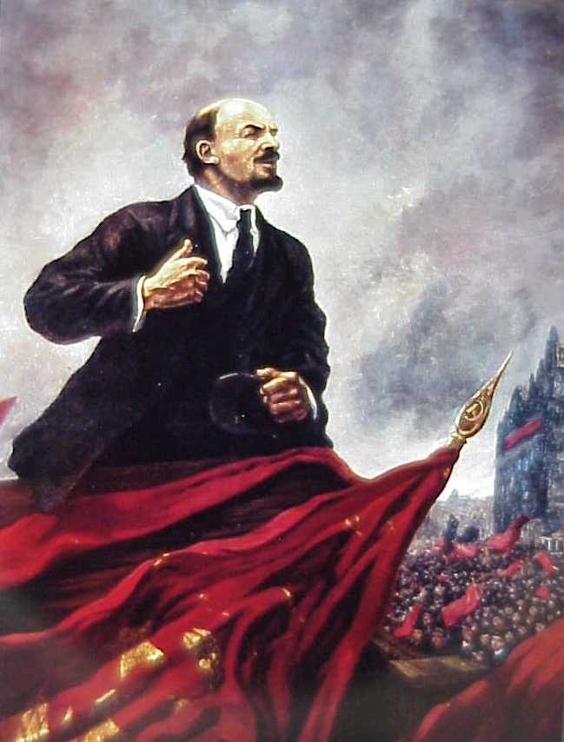
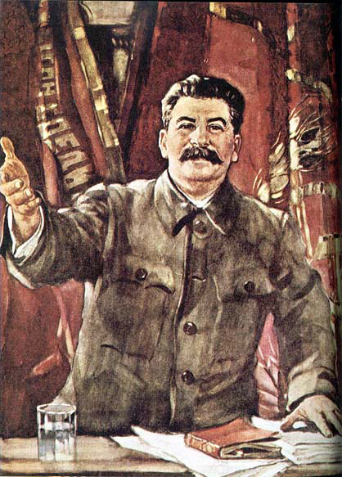
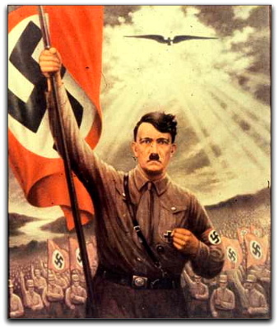
We’ve already looked at responses to classical liberalism (Classical conservatism, Marxism, socialism, and welfare capitalism).
Now we will look at ideologies that completely rejected liberalism in favour of totalitarian systems of government such as the Soviet Union and Nazi Germany.

Slide 5
Why did totalitarianism emerge?
Communism and Fascism were the two most influential ideologies to reject liberalism and both used totalitarian forms of government.
Totalitarianism means complete control of the government over the public and private lives of its citizens.
“Everything within the state, nothing outside the state, nothing against the state.”
-Benito Mussolini

Slide 6
The nature of totalitarian regimes
Totalitarian regimes are responding to what they see as dangerous and destabilizing changes. They consider the existing society in need of a complete transformation.
These transformations may be...

Slide 7
radical
reactionary
As in the USSR
The change desired is a move toward the far left side of the economic spectrum and a complete rejection of political and economic traditions of the past
As in Nazi Germany
The change desired is a move toward an idealized past and an acceptance of economic inequality (accepting the belief that some people are naturally better than others.)

Slide 8
Political Freedom
United States
Anarchy
Canada
Economic Control
Economic
Freedom
USSR
Totalitarianism
Nazi Germany
Political Control
Refer to page 168 of your text

Slide 9
Like most ideologies, totalitarian regimes provide an account of the past, and explanation of the present, and a vision for the future. However, the extensive use of propaganda, coercive power, and communications technologies ensure the totalitarian governments maintain strict control over their citizens. This can include:
Extensive local, regional, and national organization
Youth, professional, cultural, and athletic groups (often forced participation)
A secret police using terror
Indoctrination through education
The censorship of the media
Redirecting popular discontent (using scapegoats)

Slide 10
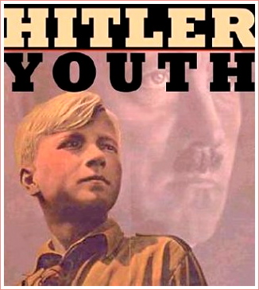
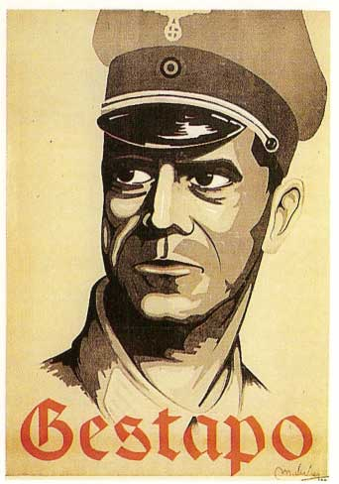
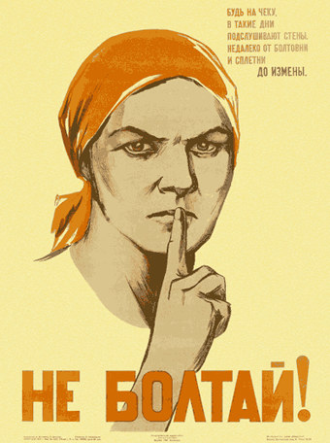
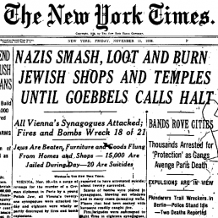
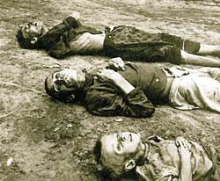

Slide 11
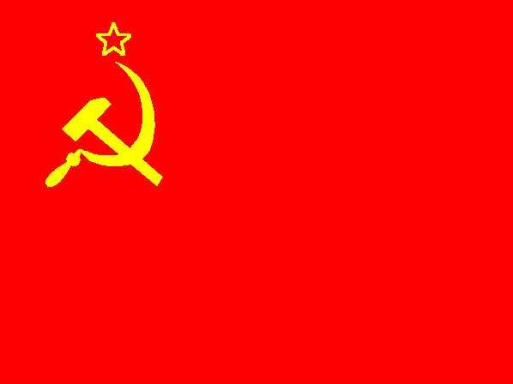
We will examine the rejection of Liberalism in Russia (USSR) and Nazi Germany

Slide 12
The rise of totalitarianism in russia

Slide 13
More then 80% of Russians were peasants; some of them were serfs (low income farmers who worked and were bound to the land of wealthy land-owners)
Czar Alexander II announced the emancipation of the serfs in 1861 but the government was slow to implement the changes.
Thus the reforms did little to satisfy Russian citizens

Slide 14
From the 1860s to the early 1900s Russia underwent massive change
Classical liberal economic policies led to rapid industrialization but Russia still lagged behind the rest of Europe
Russia also remained autocratic as the monarchy did not want to relinquish power
In 1881 the Czar was assassinated and Czar Alexander III took power. He imposed stricter political control; he exiled and persecuted dissidents using a secret police force.

Slide 15
Lenin and the rise of communism
Czar’s government was inefficient and authoritarian
Food shortages were common
The secret police were ruthless
Vladamir Lenin (1870-1924) appealed to the struggling workers
A revolution broke out in 1905 and although it was suppressed, the Czar was forced to allow some reforms such as basic human rights, universal suffrage, and the creation of an elected Legislative Assembly called the Duma

Slide 16
These reforms were not enough to satisfy the people, especially since the Czar limited the powers of the Duma before its first session
The Fist World War broke out in 1914 which intensified the problems in Russia
In February 1917 discontent developed into an outright revolution.
Lenin’s communist Bolsheviks took over the machinery of the government in an organized attack in October 1917

Slide 17
“Land, Peace, and bread”
Lenin and the Bolsheviks believed that violent revolution was the only way to overthrow the government and avoid further development of liberalism in Russia
However taking power was easier than staying in power; a civil war erupted and lasted for 5 years.
By 1922 the war was over and communism was established
By 1924 Russia became the Union of Soviet Socialist Republics (USSR or Soviet Union), a dictatorial rule by the Communist Party

Slide 18
The rise of totalitarianism in germany

Slide 19
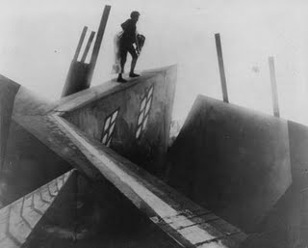
Aftermath of the first world war
Immediately after the First World War in 1919, Germany became a republic with a modern, liberal democratic political structure.
This became known as the Weimar Republic

Slide 20
The treaty of versailles
German army of no more than 100 000 men and no tanks
Reduce German navy, no submarines
No German air force
Alsace-Lorraine returned to France
Germany loses all it’s colonies
Rhineland became demilitarized
Anschluss (union) with Austria forbidden
Germany forced to recognize Poland and Czechoslovakia
Germany had to sign the War Guilt Clause (Article 231) which placed blame on them
A Reparations Commission decided Germany should pay $33 billion US, they eventually paid $713 million US.

Slide 21
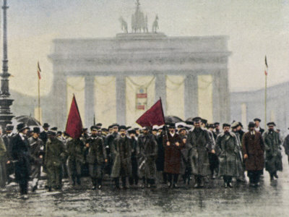
Even though Germany had little choice in signing the treaty, much of the German population blamed the government for the humiliation and economic hardship the treaty was cause for years to come.
This resentment would undermine German confidence in their liberal democratic government
Furthermore, many Germans associated liberalism with the countries that defeated them in WW1

Slide 22
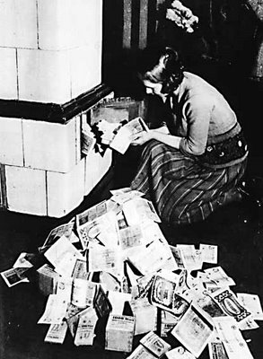
Economic turmoil
After WW1 the German economy was in ruins
Germany had trouble with the reparation payments and
massive inflation saw savings
being wiped out
Just when the economy started to improve the stock market crash of 1929 and the Great Depression plunged the country into economic hardship once again.

Slide 23
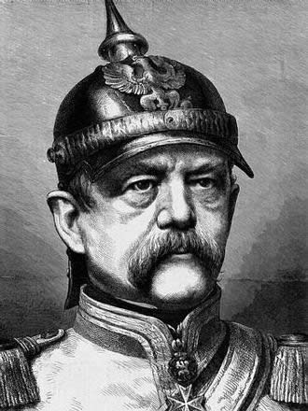
A legacy of authoritarian rule in germany
Since the creation of the German Empire in 1871 the government was authoritarian in many ways
The Kaiser and the Chancellor held power and created a welfare state with health, accident, old-age, and disability insurance.
Hence, many Germans saw authoritarian ayatem as benevolent.

Slide 24
Nationalism, militarism, and law & order
When the Weimar Republic failed to provide Germans with any hope in hard times they looked back to authoritarian rule
Hitler capitalized on their fears
Adolf Hitler’s Nazi party:
promoted absolute nationalism, which called for the unification of all German-speakers
Used paramilitary organizations to stifle dissent and to terrorize the opposition
Centralized decision making in a single leader to whom everyone owed loyalty

Slide 25
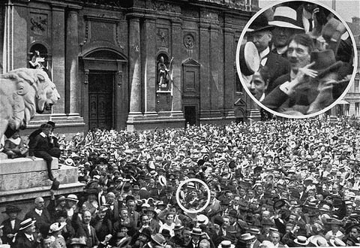

Slide 26
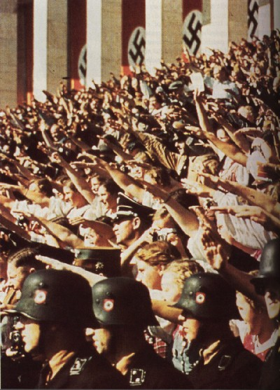
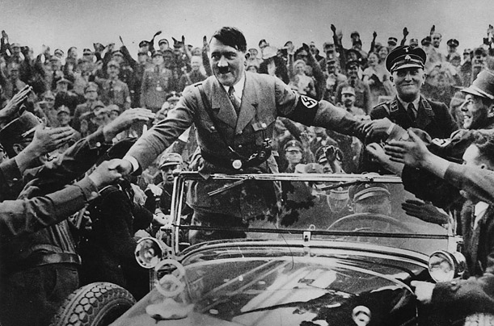
The Nazis’ advocacy of law and order appealed to many Germans who were tired of years of instability

Slide 27
Read the GET TO THE SOURCE section on page 176 of your text entitled The Program of the Nazi Party and answer questions 1-3 at the bottom of the page

Slide 28
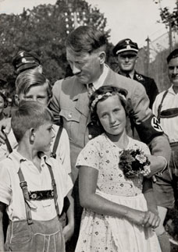
Theories of racial superiority
Nazi ideology included a racial theory that claimed that Germans formed a superior, “Aryan race”
They also used Jews as a scapegoat; they claimed that the Jews were the cause of many of Germany’s problems
Anti-Semitism was not unique to Germany, many Christians blamed the Jews for the crucifixion of Jesus

Slide 29
You must be familiar with forms and purposes of propaganda. If you are unfamiliar with propaganda read page 178.

Slide 30
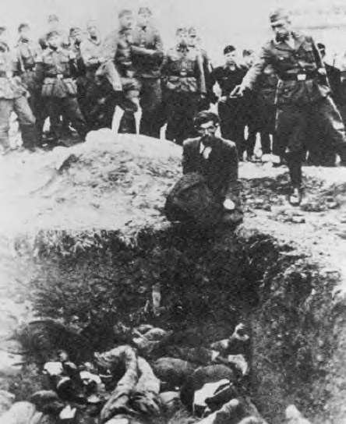
Living with communism and nazism
How did ideologies that rejected liberalism affect citizens?
Any benefits that came out of these two ideologies were outweighed by the devastating costs to many of the people living in those countries.
While some citizens benefited, many others suffered or died.
Is it reasonable to suggest that the rejection of liberalism can be dangerous for citizens?

Slide 31
Communism in the soviet union
Marx and Engels had developed theories of communism with Western European society in mind.
Lenin believed Marxism had to be carried out differently in Russia
This came to be called “war communism” but the conversion could not take place as quickly as first hoped
In 1921, Lenin introduced the New Economic Policy which brought back some aspects of capitalism temporarily to stimulate the economy
The state retained control of banking, large industry, transportation, etc

Slide 32
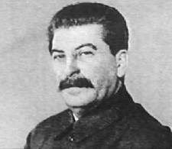
Stalin: 5 year plans & collectivization
Lenin death in 1924 led to a 4 year
struggle for power until Joseph Stalin
took power
Stalin continued with making Russia more communist by centralizing economic planning and implementing 5 year plans (industrial production increase by 20% per year)
The government implemented collectivization-all land was taken away from private owners and combined into large, collectively worked farms

Slide 33
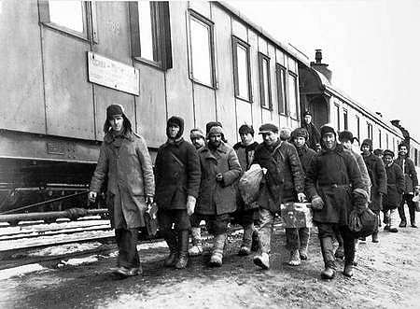
Along with collectivization came the persecution of the kulaks-a class of prosperous lan-owning peasants
Kulaks who did not give up their property were arrested and deported, or in some cases executed; they became the scapegoats of collectivization

Slide 34
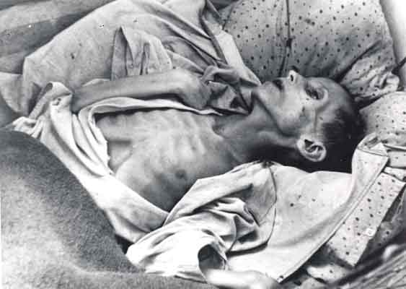
Few peasants were satisfied with the changes, some destroyed crops and farm equipment, and slaughtered their animals rather than give them up to the state
These disruptions to agricultural production led to food shortages such as the Holodomor in Ukraine

Slide 35
Stalin eliminates political opposition
Some became disillusioned with Stalin’s leadership
He responded with a period of political repression known as the Great Purge (1936-1938)
Political opponents were executed or sent into exile, it included most of the highest ranking officers of the Red Army
Almost 2 million were arrested, half of them executed; the rest sent to forced labour camps in Siberia. These camps were known as the Gulag

Slide 36
Leadership:
Germany is Hitler, Hitler is Germany
Total allegiance
Big Business-State-Military Partnership
Cooperation between these aspects of society
Racism
Superiority of the Aryan race, anti-Semitism, eugenics

Slide 37
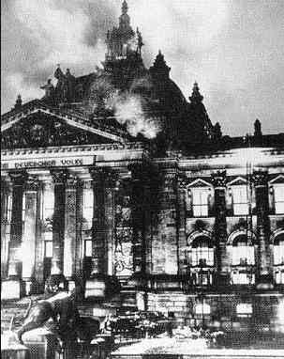
Consolidating power
In November 1932, the Nazi party held 1/3 of the seats in the Reichstag. By 1933 Hitler was named Chancellor. Capitalizing on the situation he quickly turned Germany into a totalitarian state.
A fire in the Reichstag was used by Hitler to spread fear of a communist takeover. Although it is believed the Nazis actually started the fire he used the incident to solidify his power

Slide 38
Hitler passed the Reichstag Fire Decree and Enabling Act in 1933 which made it possible to:
Restrict personal freedom, freedom of opinion, freedom of the press, and freedom of organization and assembly
Eliminate the privacy of mail, telegrams, and phone conversations
Eliminate the need for warrants to conduct searches
Pass legislation through the office of the Chancellor without the approval of the Reichstag
Ban all political parties except the Nazi party

Slide 39
Germany has become a dictatorship by 1933
The Nazis purged Germany of opposition to them
When President Hindenburg died August 19, 1934, Hitler declared himself Führer
While individual rights suffered, the economy benefitted: 6 million Germans were unemployed in 1932, in 1936 only 1 million were unemployed
Foreign imports were restricted to promote German products designed to achieve autarky (self-sufficiency and independence from other nations)

Slide 40
Nazi Eugenics
Nazi ideology promoted the superiority of the Aryan race and eugenics-controlling human reproduction so that desirable genetic traits are encouraged and undesirable traits are eliminated
9-11 million people, including 6 million Jews, who were considered Untermenschen (sub-humans) and were killed by the Nazis
Read the GET TO THE SOURCE section at the top of page 190 and we’ll discuss it

Slide 41
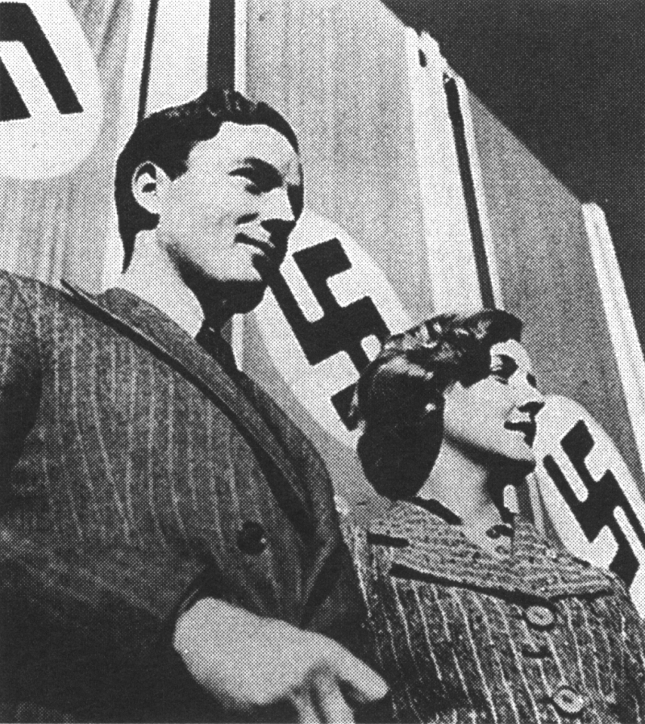
The strict enforcement of law and order gave people a sense of security
Transportation improved
Rallies and propaganda brought hope and confidence
Hitler “is my mother and my father. He keeps me safe from all harm”

Slide 42
Women and youth
Nazi Germany was a patriarchy dominated society. Women were primarily to stay at home and raise children
Couples were rewarded for having children (pg 192)
The Nazis also saw the importance of young people as the future of the Reich
Children were active participants in Nazism and were even encouraged to report anti-Nazi acts even by their parents

