Slide 1
The Evolution of Modern Liberalism
Chapter 6 – Unit 2

Slide 2
Chapter 6 Issue
The economic conditions that made possible the immense fortunes of Frick (known for his ruthless business practices) and other robber barons like him were largely due to the adoption and the principles of economic liberalism in the United States, Canada, Great Britain, and other industrialized countries near the beginning of the 20th century.
This chapter explores how various historical events and competing ideologies influenced the development of liberalism in the 20th century, and how liberalism then impacted the societies in which it took hold.

Slide 3
Principles of Liberalism
Classical liberalism stresses the importance of human rationality. Just as it values political freedoms, classical liberalism also holds freedom to be the basic standard in economics, and believes the most beneficial economic system to be the “free market”: an economy that operates with limited government intervention and relies on the choices that rational individuals make in their own self-interest.

Slide 4
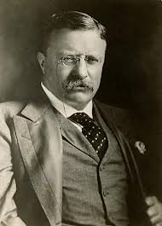
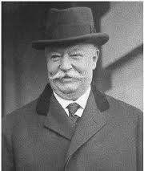
Liberalism in North America
Theodore Roosevelt introduced several reforms during his presidency to give middle-class Americans a “square deal.”
Part of this square deal involved preventing large companies from abusing their control over the marketplace. One of the companies Roosevelt’s government investigated was the Standard Oil Company.
Roosevelt’s successor was William Howard Taft, who served as president from 1909 to 1913.

Slide 5
Liberalism in North America
Taft pursued several of the progressive initiatives started by Roosevelt, such as breaking up trusts—that is, large business multinationals that exerted monopolies (exclusive possession and control of a company)
The Sherman Anti-Trust Act (John Sherman 1890) was not intended to prevent a single company from dominating a market in a “monopoly by merit,” but to prevent anti-competitive behaviour among companies.
It prohibits certain business activities that reduce competition in the marketplace

Slide 6
The Sherman Anti-Trust Act
The Act prevented a business entity (such as a trust) from owning two or more competing companies. For example, competing oil companies could not be owned by the same parent company.
In 1911, President Taft and the US Supreme Court used the Sherman Anti-Trust Act to force the Standard Oil Company to break up into 34 smaller, independent companies.
While it was the economic principles of classical liberalism that allowed the Standard Oil Company to grow to such a position of market dominance, this position eventually led it to undermine other classical liberal principles such as competition.

Slide 7
Reform
Similar cases in other industries led to a period of reform in North America that saw greater government regulation of commerce.
These reforms limited to some extent the classical liberal freedoms and principles of the marketplace.
At the same time, the reforms prevented certain powerful entities in society from abusing the rights and freedoms of less influential organizations and individuals.

Slide 8
Credit Unions
In the late 19th and early 20th centuries were forming labour unions to counteract the power of big business, the first credit unions were formed in North America.
Credit unions (first created by Alphonse Desjardins):
started as small financial institutions owned by their members; profits are used to offer members better lending rates or lower fees.
Began as an alternative to traditional commercial banks, which would often not service smaller communities or provide loans to borrowers with no credit history.
While the group ownership and profit-sharing operation of credit unions went against classical liberal principles, they provided access to financial services to a wider range of individuals than traditional banks did.

Slide 9
The First Red Scare
The American political climate of the 1920s was prepared by a period known as the “First Red Scare” (1917–1920).
Red Scare = the colour red being associated with the Bolshevik Red Army of the Russian Revolution.
The Russian Revolution fuelled public fears of a similar communist uprising in the United States, while inspiring those with leftist political ideologies.
Several large labour strikes in Seattle, Cleveland, Pittsburgh, and other cities in 1919 and 1920 contributed to the public perception that support for socialism and communism in America was growing.

Slide 10
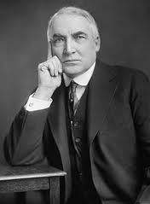
Warren G. Harding became president of the United States in 1921.
He was elected by the widest margin of any president in American history. Harding campaigned on a platform that promised a “return to normalcy.” The three central ideas of this platform were
1. isolationism—a retreat from involvement in other countries’
affairs, especially European countries
2. nativism—the promotion of policies that favour the existing
dominant culture in a country and reduce immigration
3. a reduction of government involvement in the lives of citizens
With the Revenue Act of 1921, Harding reduced income taxes, and repealed the excess profits tax that had been applied to corporations during the First World War.

Slide 11
Calvin Coolidge
When Harding died (1923), his vice-president, Calvin Coolidge, assumed the presidency, and won the 1924 presidential election.
Coolidge favoured similar policies to those of Harding.
Coolidge’s administration of the 1920’s implemented policies reflecting his laissez-faire stance.
Personal income taxes were further reduced with the Revenue Act of 1924 and reduced again with the Revenue Act of 1928.

Slide 12
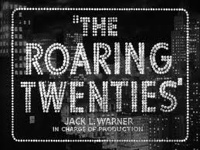
The Roaring Twenties
The United States included an ideal of equality, but it was an equality of opportunity, rather than circumstance: everyone would have a chance at attaining prosperity, but only those who deserved it (through hard work) would achieve it.
Factories switched to the production of consumer goods, and the economy continued to grow until 1929.
Consumerism increased dramatically over the course of the decade.
As the free market economy expanded and rapidly modernized, major changes also occurred.

Slide 13
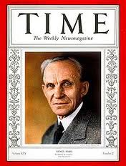
Henry Ford
Industrialists such as Henry Ford (founder of Ford Motor Company) helped spur the economic boom by pioneering techniques such as mass production (assembly lines and mechanization to produce large volumes of a product at a cheaper price).
Ford also used the practices of welfare capitalism he advocated a minimum wage and a 40-hour workweek in his factories.
Ford’s motivation was financial, however; he reasoned that if his employees were happier, they would work more efficiently.
He also believed that paying them better wages would allow them to buy the products they produced, thus increasing sales.
These and other advances in manufacturing made a variety of products cheaper, and consumer spending—or consumerism—increased dramatically over the course of the decade.

Slide 14
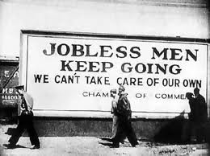
The Great Depression
The industrial expansion of the late 19th and early 20th centuries created a noticeable income disparity, or difference in earnings, between rich and poor.
Following the extended period of prosperity in the 20’s the economy would cycle into the severity of depression in the 1930’s—this period would have a long lasting influence on liberal democratic governments.

Slide 15
Long-Lasting Effects
Most economists see booms (periods of economic growth such as the growth in the 1920s) and recessions as normal parts of the free market business cycle.
Because of various circumstances, however, the recession of the 1930s was extremely severe.
This period would have a long-lasting influence on liberal democratic governments. It led to a growth in government involvement in economies that continues in many forms to this day.

Slide 16
1929 & continuing factors
During the prosperity of the 1920s, the stock prices of successful companies rose.
Many people began borrowing money to invest in the stock market on the assumption that prices would continue to rise.
These investments actually inflated the stock prices.
When prices finally stopped rising, people began selling their stocks to make profits prior to prices dropping. As demand for stocks dropped so did their prices. Panic selling caused prices to fall even more quickly—which led to crash.

Slide 17
The Aftermath
After the crash, investors who had borrowed money to buy stocks found themselves with large debts and worthless investments.
Fearing a wider economic downturn after the crash, banks began calling in loans—many who had overextended themselves became bankrupt.
People feared about what little savings they had in the banks and bank runs became common. Bank runs are a situation when too many depositors try to withdraw their savings from a financial institution causing it to go bankrupt. When the banks went bankrupt, so did businesses that had borrowed from them to survive

Slide 18
The Aftermath
Some economists also believe that industry and agriculture had become too productive in the 1920s, leading to a glut of products on the market, and a corresponding fall in prices.
Next the American government began introducing tariffs(tax on import & export) to protect the domestic economy. Nations of the globe responded by creating their own tariffs.
The result was slowed international trade and a slowed global economy.
A general loss of confidence in the North American economy prevailed causing the people who did have money to spend even less, further slowing the economy.
To add insult to injury, North American farmers were hit by a series of droughts and insect plague.

Slide 19
The Great Depression and its effects would cause a greater number of people in North America to question the wisdom of the prevailing classical liberal economist system. (capitalism)
In Canada, the Co-operative Commonwealth Federation (CCF) was founded in Calgary in 1932 with mixed economic policies such as public ownership of industries and financial institutions.
People would begin to believe that the government should take on a greater role to prevent extreme fluctuations in the business cycle—and provide society with greater economic stability.
This signaled a significant shift away from classical liberalism toward a mixed economy and a more modern understanding of liberalism.

Slide 20
The Postwar Consensus – period in politics from the end of WWI (1919) until the end of the 1970s.
Countries like Britain, Canada, and the United States implemented changes in the role of the state at this time, but they also saw general growth of the principles of liberalism which occurred internationally through contact related to trade, international cooperation, foreign aid, and other programs.

Slide 21
Postwar Consensus
Saw the development of “social safety net” programs such as:
Employment insurance
Assistance for the elderly
Child care
Universal health care
All of these programs were made possible by
National Insurance Act
The National Assistance Act
The National Health Service Act

Slide 22
The Postwar Economy in Canada
In the 3 decades following WWII, the Canadian government created and strengthened social programs.
Prior to and during the World Wars, legislation introduced
Unemployment insurance
Family allowance
The Canadian government was working towards programs characteristic of a welfare state (the state plays a key role in the protection and promotion of the economic and social well-being of its citizens: equality of opportunity)

Slide 23
The Postwar Economy in Canada
Universal Health Care
Canada Pension Plan (CPP) & Old Age Security
Foreign Investment Review Agency (FIRA) promoting foreign investment in the Canadian economy
Canadian Radio & Television Commission (CRTC)
Atomic Energy of Canada Limited (AECL) fed. government to control uses for nuclear energy.
These programs were a step in the right direction to ensure that the Economy could see growth but they weren’t out of the crises yet.

Slide 24
Economic Crises of the 1970s
In 1973, Egypt and Syria attacked Israel.
In response to American and Western European support of Israel during this time of conflict Organization of the Petroleum Exporting Countries OPEC reduced oil production and limited exportation.
The price of oil quadrupled, causing gas shortages and rationing in the United States.
This had a double effect of making goods more expensive (inflation) and a slow in the economy.
When a recession and high inflation occur at the same time, it is known as stagflation.

Slide 25
Stagflation
Due to the phenomenon of stagflation, governments in many Western countries found that, while the cost of maintaining programs of a welfare state was rising due to inflation, the economic slowdown meant that governments collected less tax revenue.
This situation led to a shift in economic thinking in many countries in the 1970s and 1980s.

Slide 26
Monetarism
Another swing in the economic pendulum alternates between interventionism and the free-market economy is Monetarism.
The theory holds that control of a country’s money supply is the best means to encourage economic growth and limit unemployment and inflation.
They money supply is controlled through the regulation of interest rates.
Economists like Milton Friedman and Friedrich Hayek believed that the price system, or the free market was the only way to balance supply and demand in the economy while maintaining individual liberty.

Slide 27
Monetarism
The adoption of monetarism by Great Britain, the United States and others reflects a swing of the pendulum back to classical liberal principles and away from the interventionist practices of Keynesian economics.
The intervention of governments during and after the Depression and WWII had established a modified market or a mixed economy – the intervention side of the pendulum swing – but the advice offered by Keynes had been only partially accepted by governments.

Slide 28
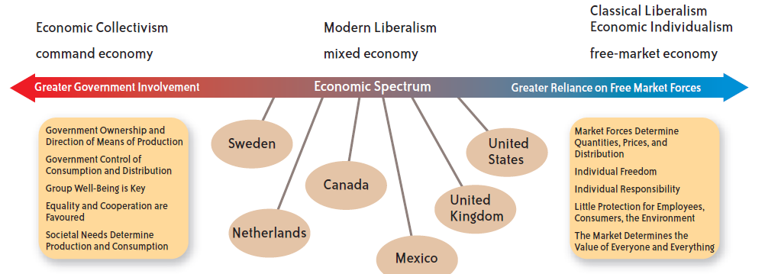
Economic Liberalism Today
In addition, changes in governing parties often lead to changes in economic policy in liberal democracies.

