Slide 1
Ideologies of Individualism & Collectivism
Chapter 2

Slide 2
When we examine ideologies, we can see that each of them is based on either individualism or collectivism, or a mixture of the two.

Slide 3
What is the relationship between the individual and society?
Individualism
Collectivism
Stresses the importance of ideas such as personal autonomy-a state of individual freedom from outside authority-and self-reliance-being solely responsible for one’s own well-being
Stresses human interdependence and the importance of a collective, regardless of the size.
It emphasizes group goals and the common good over individual goals or individual gain.
*These are not single ideologies, many separate ideologies are based on these two principles.

Slide 4
Some Early Understandings of Individualism and Collectivism
24th century BCE in Mesopotamia, first to create property laws
4th century BCE, “...Everyone thinks chiefly of his own, hardly at all of the common interest...” Aristotle
Hutterites live and work for the common good of their communities
Review the other historical understandings on pages 65-70.

Slide 5
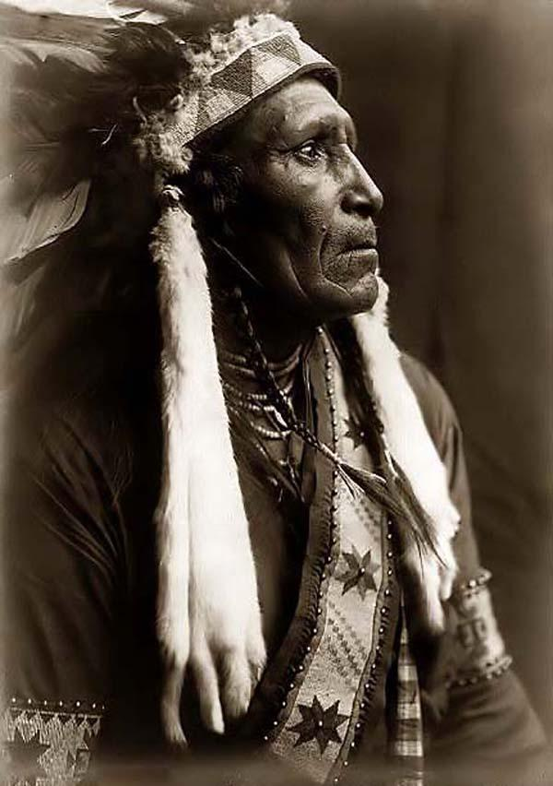
An Aboriginal Understanding of Collectivism
Aboriginals believed the creator allowed them to live on the land, to share it. Land ownership was not heard of until European arrival.
Decision making, education, and raising children were done collectively.

Slide 6
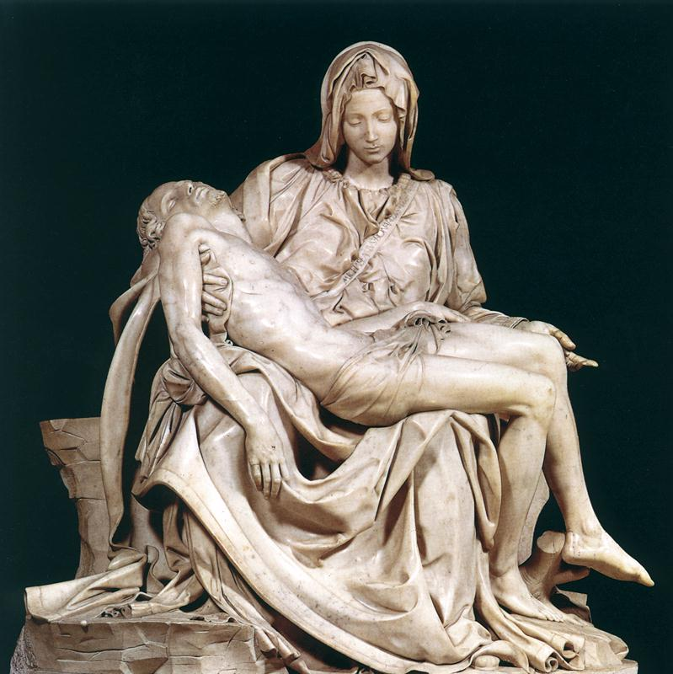
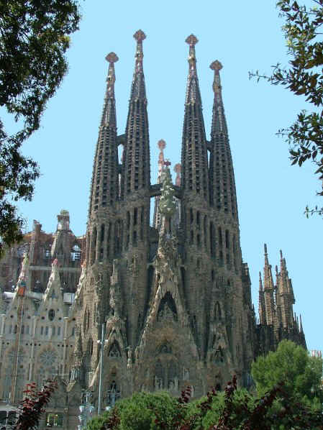
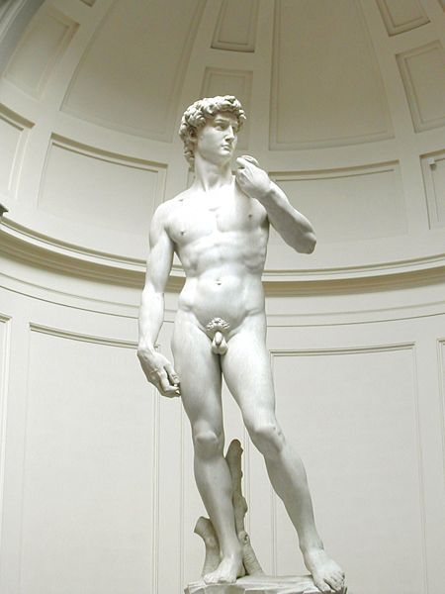
Ideas of Collectivism and Individualism in Art and Writing

Slide 7
Principles of Individualism
Individualism is one possible foundation of ideology and is a foundation in particular of liberalism, the prevailing ideology in Western democracy
Rule of law
Individual rights and freedoms
Private property
Economic freedom
Self-interest
competition

Slide 8
Individualism Rule of Law
Rule of law is a key principle in liberal democracies that states that every individual is equal before the law and all citizens are subject to the law
Are there instances in our society where this is not the case?

Slide 9
Individualism Individual Rights and Freedoms
Freedom of religion,
speech, security, liberty, etc.
In the past only certain people had these rights, for example men, the first class, certain religions, certain cultural groups, etc.
Sometimes certain freedoms must be limited such as legal voting age, or balancing freedom of speech against promotion of hate or discrimination.

Slide 10
Individualism Private Property
At first, property law was understood to only apply to land but eventually came to apply to 3 types of property
Real estate-land, water, air corridors, etc
Physical possessions-stereos, cars, etc
Intellectual property-writing, artwork, music, etc

Slide 11
Individualism Economic Freedom
Economic Freedom is the freedom to buy or sell whatever you want from/to whomever you like.
It is free of government intervention, a free market
Canada can be considered a welfare state-a state which is capitalist but the government uses policies to ensure economic stability

Slide 12
Individualism Self-Interest and Competition
When people act in their own self-interest they are in competition with others which benefits all in the society (supply and demand).
Adam Smith saw self-interest as an “invisible hand” that guides individuals to contribute for the common good of everyone.
However, in some cases the rich get richer and the poor stay poor

Slide 13
Principles of Collectivism
Principles of collectivism are the foundation of ideologies such as communism and socialism.
Over time most liberal democracies have evolved to incorporate aspects of collectivism into their political, economic, and social systems.
Economic equality
Co-operation
Public property
Collective interest
Collective responsibility
Adherence to collective norms

Slide 14
Collectivism Economic Equality
Economic equality can mean:
People with larger income pay higher taxes
All people should earn equal pay for similar work
There should be a guaranteed annual income (GAI)
All people should share in the wealth of the country or world
People should own the means of production collectively
Everything should be free (no private property)

Slide 15
Collectivism Co-operation
Co-operation is the means through which members of a group or a collective achieve their common goals.
Some co-ops exist in Canada today

Slide 16
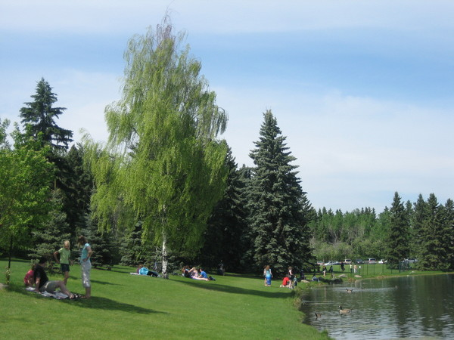
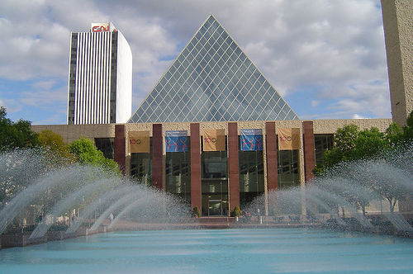
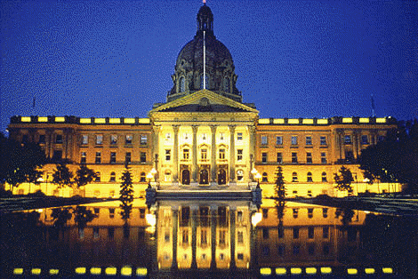
Collectivism Public Property
Public property is anything-land, buildings, vehicles-not privately owned by individuals
They are maintained with public money/taxes and can be used by all members

Slide 17
Collectivism Collective Interest
Collective interest refers to the set of interests that members of a group have in common.
While individual members may have individual interests, these interests are often better addressed by making them a common set of interests that the group can address together
Labour unions are an example of common interests as they fight for better pay and working conditions.

Slide 18
Collectivism Collective Responsibility
Collective responsibility means holding the whole group responsible for the actions of individuals (or individual groups) within the group.
E.g.-“...underage drinking cannot be successfully addressed by focusing on youth alone. Youth drink within the context of a society in which alcohol use is normative behaviour and images about alcohol are pervasive.”
In totalitarian states such as N. Korea, if one member of a family opposes the state in some way an entire family can be punished to send the message that that behaviour is not tolerated

Slide 19
Collectivism Adherence to Collective Norms
Groups usually impose norms or standards on their members as a condition of membership in the group
Fraternities, political parties, faith groups, trade unions, etc, are all examples.
Censorship-deliberately restricting information shared-is another example of a collective norm.

Slide 20
When speaking of individualism and collectivism, people sometimes try to suggest that the two viewpoints are incompatible.
While there are times that they are at odds, there are often aspects that compliment each other.
Sometimes individualism and collectivism work together for the common good of society.

Slide 21
Americans are well known for their emphasis on the principle of individualism
Even so, the majority of North Americans believe that government should provide help to those who need it, and idea that is essentially collectivist

Slide 22
Attitudes about Individualism and Collectivism in N. America

Slide 23
Social capital is the strength of social relationships between individuals
Some researchers have claimed that increased individualism in a society leads to an increased sense of commitment to the collective
Indications lead us to believe that individualism and collectivism are not opposing concepts

Slide 24
Individualism and Collectivism Co-Exist through:
Entrepreneurialism-people pursue success individually but successful businesses do things beneficial to the collective like provide jobs or do positive things
Social Programs- A country like Canada can be individualistic but also has social programs (health care, welfare, etc) that provide for all
NGOs- these are created with specific goals in mind to benefit the community but are also privately created and funded
Read the other examples on pages 90-95.

Slide 25
End of Unit Activity
Choose one of the following activities and do it for homework:
Read the INVESTIGATION section on pages 92 & 93 and do questions 1 and 3.
Read the VOICES section on pages 96 & 97 and do questions 1 and 2.
Read the SKILL PATH on page 98 and do questions 1-4.
Answer all questions in complete sentences. While you are only required to do one of the above assignments, understanding the concepts of all 3 are important for the exam.

